Slide 1
Shandong Housda Smart Home Co.,Ltd.

Slide 2
目录
ProductIntroduction
01
Company Overview
03
CONTENTS
02
Core Technological Innovation
04
Quality & Service Commitment

Slide 3
Company Overview
1

Slide 4
About Us
The production base of Shandong Haoshida Smart Home is located in Dong'e Economic Development Zone, Liaocheng City, Shandong Province. It was self‑funded with advanced manufacturing technologies and modern management concepts. Through continuous efforts, it has grown into an integrated and diversified manufacturing enterprise. As a model for local economic development and a benchmark for hometown‑returning entrepreneurship, the project receives high attention and strong support from local government authorities.
As a professional source manufacturer of small home appliances, our factory boasts 10‑years of industry experience. We are engaged in independent R&D, production and sales of fans and heating appliances.
We adopt full‑process in‑house production with rigorous quality management. We support OEM and ODM customization and provide fast‑sampling service. Our products have been sold to over 30 countries across the globe and can meet different international certification standards. We have established long‑term cooperation with many well‑known domestic brands, offering reliable one‑stop procurement solutions for global partners.

Slide 5


Industry-Leading Manufacturing Service Provider of Small Home Appliances
Corporate Positioning & Vision
Core Competitiveness
We specialize in manufacturing small home appliances. With advanced production equipment and exquisite craftsmanship, we strictly monitor every production procedure. Adhering to high quality standards from R&D to shipment, we commit to creating practical, durable and innovative small home appliances to satisfy varied living needs.
Our factory covers integrated services including injection molding, motor production, carton manufacturing, spraying and assembly. Supported by advanced facilities and professional teams, we enforce strict quality control from raw material processing to final assembly. We aim to deliver one-stop, premium products and services to satisfy diverse customer requirements.

Slide 6
Core Technological Innovation
2

Slide 7

Breakthrough Heating Technology
Smart Far-Infrared Graphene Quad-Core Heating System
The innovative quad-core distributed heating structure works with a smart temperature sensor network to deliver temperature uniformity of ±1°C within a 50 m² area. The system automatically adjusts the power of each heating unit based on room layout to prevent local overheating, making it ideal for sensitive users including mothers and babies as well as light sleepers.

Slide 8
Efficient Air Circulation Technology
DC Brushless Inverter Motor System
Fluid Mechanics Optimized Air Duct Design
01
02
It adopts the 5th-generation DC brushless motor with speed regulation accuracy up to 1 rpm and efficiency increased to 92%. It saves over 50% energy compared with traditional AC motors.
The motor service life reaches 50,000 hours. Equivalent to 17 years of continuous operation with 8 hours of daily use, and operating noise is controlled below 25 decibels.
Developed in-house by our R&D team, the bionic turbine air duct pairs with seven spiral noise-reducing blades. Air volume rises by 15% and noise drops by 40%. Its unique air guide structure delivers a 12-meter airflow distance and increases coverage by 30%.
Smart Wind Speed Regulation System
Integrated Air Purification Technology
03
04
Combining 100-level stepless speed control and infrared human sensing, it intelligently modulates wind speed and airflow angle based on user location and movement. If users stay beyond 3 meters for 5 minutes, the unit automatically enters energy-saving mode with 70% lower power consumption.
Certain premium models come with built-in HEPA filters and negative ion generators. Boasting 99.7% PM2.5 filtration efficiency and releasing 3 million negative ions per cm³, they combine air circulation and purification, perfect for families with allergy sufferers.

Slide 9
Product Introduction
3

Slide 10
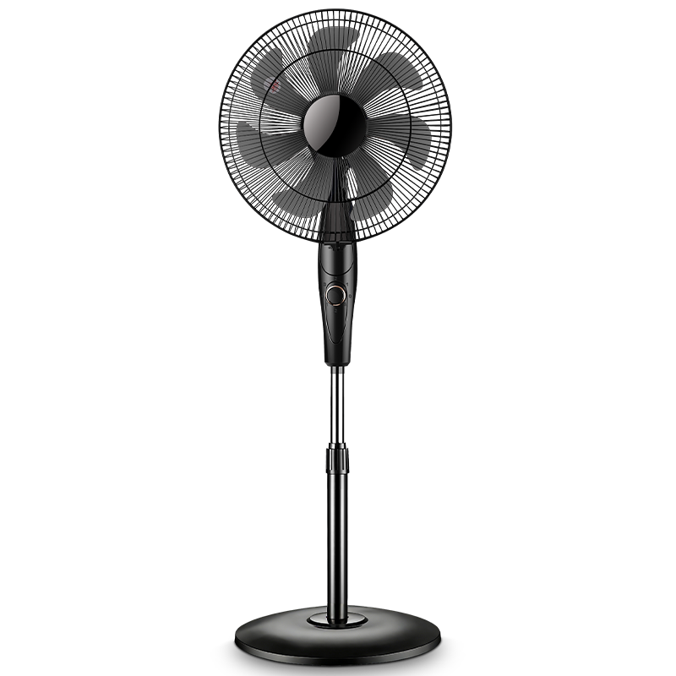
Specifications：16 Inch Floor Fan-FS09-16F1（Customizable）
Product Specifications |  | Customizable | Product Selling Points
Rated Voltage | 220V~50Hz | ✓ | 3-speed rotary knob control
Rated Power | 60W | ✓ | Left & right oscillation
Body Material | Metal & Polypropylene (PP) | ✓ | Adjustable fan height
Product Size | 410*380*1160mm |  | Powerful airflow, quiet operation
Carton Size | 460×190×420 mm |  | Dense safety grill protection
Control Mode | Rotary Knob Control | ✓ | Stable base with counterweight
Packing Qty. | 1 pcs/ctn | ✓ | Customizable colors
Blade Quantity | 7Plastic Blades |  | OEM & ODM supported
Oscillation | Left & Right Oscillation |  | Carton color is customizable
Packing Data |  | Packing Quantity（pcs ）
Specifications | G.W /N.W(KG) | 20GP | 40GP | 40HQ
14 Inch Floor Fan | 4.8/3.6 | 681 | 1498 | 1852

Slide 11
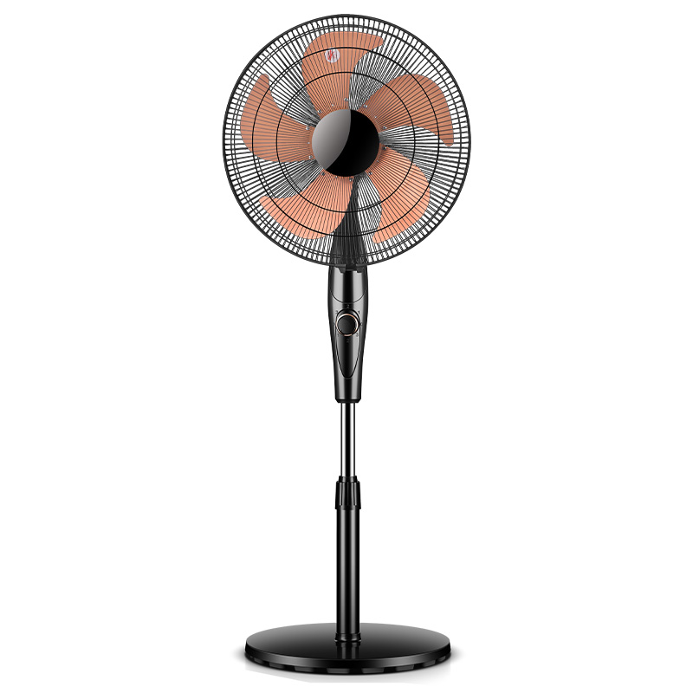
Specifications：16 Inch Floor Fan-FS09-16F2（Customizable）
Product Specifications |  | Customizable | Product Selling Points
Rated Voltage | 220V~50Hz | ✓ | 3-speed rotary knob control
Rated Power | 60W | ✓ | Left & right oscillation
Body Material | Metal & Polypropylene (PP) | ✓ | Adjustable fan height
Product Size | 410*380*1160mm |  | Powerful airflow, quiet operation
Carton Size | 460×190×420mm |  | Dense safety grill protection
Control Mode | Rotary Knob Control | ✓ | Stable base with counterweight
Packing Qty. | 1 pcs/ctn | ✓ | Customizable colors
Blade Quantity | 5 aluminum blades |  | OEM & ODM supported
Oscillation | Left & Right Oscillation |  | Carton color is customizable
Packing Data |  | Packing Quantity（pcs ）
Specifications | G.W /N.W(KG) | 20GP | 40GP | 40HQ
14 Inch Floor Fan | 4.8/3.6 | 681 | 1498 | 1852

Slide 12
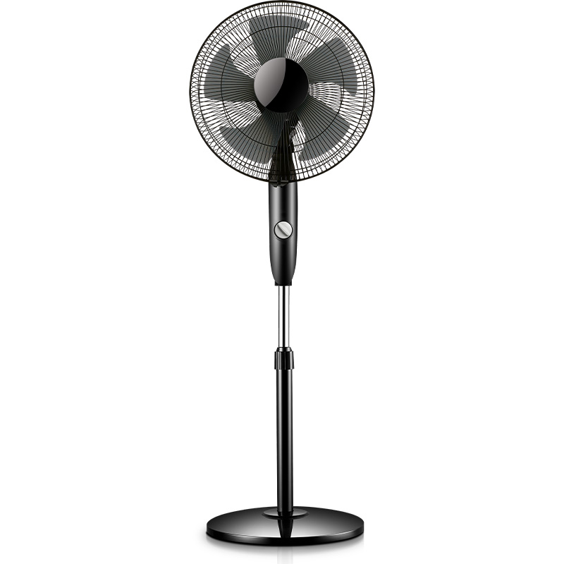
Specifications：16 Inch Floor Fan-FS-35H191（Customizable）
Product Specifications |  | Customizable | Product Selling Points
Rated Voltage | 220V~50Hz | ✓ | 3-speed rotary knob control
Rated Power | 60W | ✓ | Left & right oscillation
Body Material | Metal & Polypropylene (PP) | ✓ | Adjustable fan height
Product Size | 410*380*1160mm |  | Powerful airflow, quiet operation
Carton Size | 460×190×420mm |  | Dense safety grill protection
Control Mode | Rotary Knob Control | ✓ | Stable base with counterweight
Packing Qty. | 1 pcs/ctn | ✓ | Customizable colors
Blade Quantity | 5 Plastic Blades |  | OEM & ODM supported
Oscillation | Left & Right Oscillation |  | Carton color is customizable
Packing Data |  | Packing Quantity（pcs ）
Specifications | G.W /N.W(KG) | 20GP | 40GP | 40HQ
14 Inch Floor Fan | 4.8/3.6 | 681 | 1498 | 1852

Slide 13
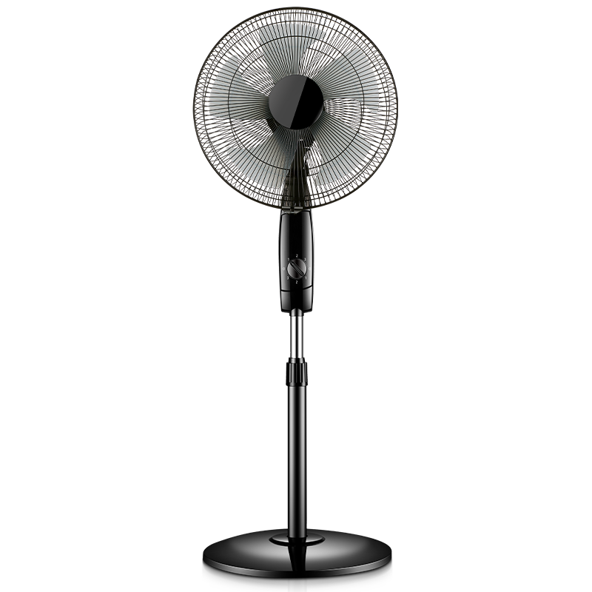
Specifications：16 Inch Floor Fan-RS-FS1001H（Customizable）
Product Specifications |  | Customizable | Product Selling Points
Rated Voltage | 220V~50Hz | ✓ | 3-speed rotary knob control
Rated Power | 60W | ✓ | Left & right oscillation
Body Material | Metal & Polypropylene (PP) | ✓ | Adjustable fan height
Product Size | 410*380*1160mm |  | Powerful airflow, quiet operation
Carton Size | 460×190×420 mm |  | Dense safety grill protection
Control Mode | Rotary Knob Control | ✓ | Stable base with counterweight
Packing Qty. | 1 pcs/ctn | ✓ | Customizable colors
Blade Quantity | 5 Plastic Blades |  | OEM & ODM supported
Oscillation | Left & Right Oscillation |  | Carton color is customizable
Packing Data |  | Packing Quantity（pcs ）
Specifications | G.W /N.W(KG) | 20GP | 40GP | 40HQ
14 Inch Floor Fan | 4.8/3.6 | 681 | 1498 | 1852

Slide 14
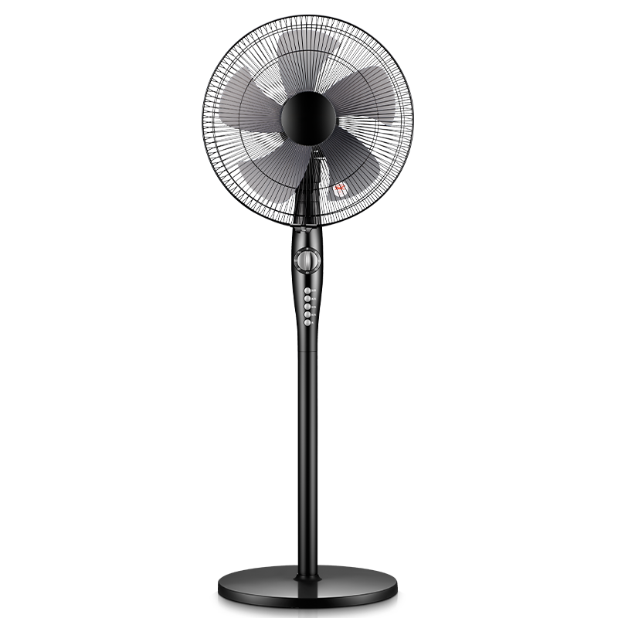
Specifications：16 Inch Floor Fan-FS09-16F3（Customizable）
Product Specifications |  | Customizable | Product Selling Points
Rated Voltage | 220V~50Hz | ✓ | 3-speed rotary knob control
Rated Power | 60W | ✓ | Left & right oscillation
Body Material | Metal & Polypropylene (PP) | ✓ | Adjustable fan height
Product Size | 410*380*1160mm |  | Powerful airflow, quiet operation
Carton Size | 460×180×365 mm |  | Dense safety grill protection
Control Mode | Rotary Knob Control | ✓ | Stable base with counterweight
Packing Qty. | 1 pcs/ctn | ✓ | Customizable colors
Blade Quantity | 5 Plastic Blades |  | OEM & ODM supported
Oscillation | Left & Right Oscillation |  | Carton color is customizable
Packing Data |  | Packing Quantity（pcs ）
Specifications | G.W /N.W(KG) | 20GP | 40GP | 40HQ
14 Inch Floor Fan | 4.8/3.6 | 681 | 1498 | 1852

Slide 15
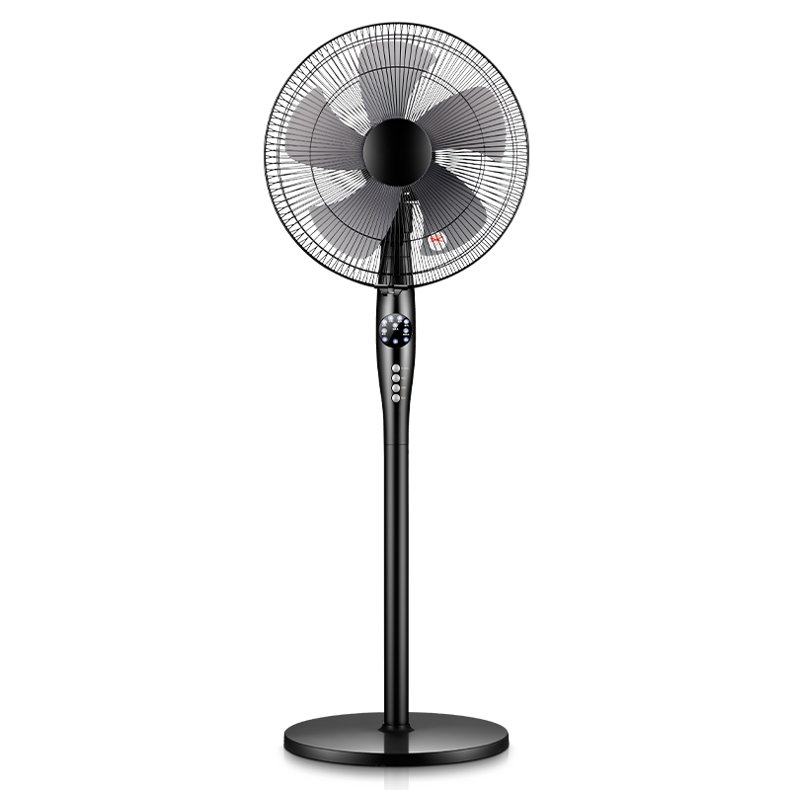
Specifications：16 Inch Floor Fan-FS09-16D3（Customizable）
Product Specifications |  | Customizable | Product Selling Points
Rated Voltage | 220V~50Hz | ✓ | 3 speed levels, remote control
Rated Power | 60W | ✓ | Left & right oscillation
Body Material | Metal & Polypropylene (PP) | ✓ | Adjustable fan height
Product Size | 410*380*1160mm |  | Powerful airflow, quiet operation
Carton Size | 460×180×365mm |  | Dense safety grill protection
Control Mode | Remote control operation | ✓ | Stable base with counterweight
Packing Qty. | 1 pcs/ctn | ✓ | 7.5-hour timing function
Blade Quantity | 5 Plastic Blades |  | OEM & ODM supported
Oscillation | Left & Right Oscillation |  | Carton color is customizable
Packing Data |  | Packing Quantity（pcs ）
Specifications | G.W /N.W(KG) | 20GP | 40GP | 40HQ
16 Inch Floor Fan | 4.9/4.1 | 719 | 1582 | 1955

Slide 16
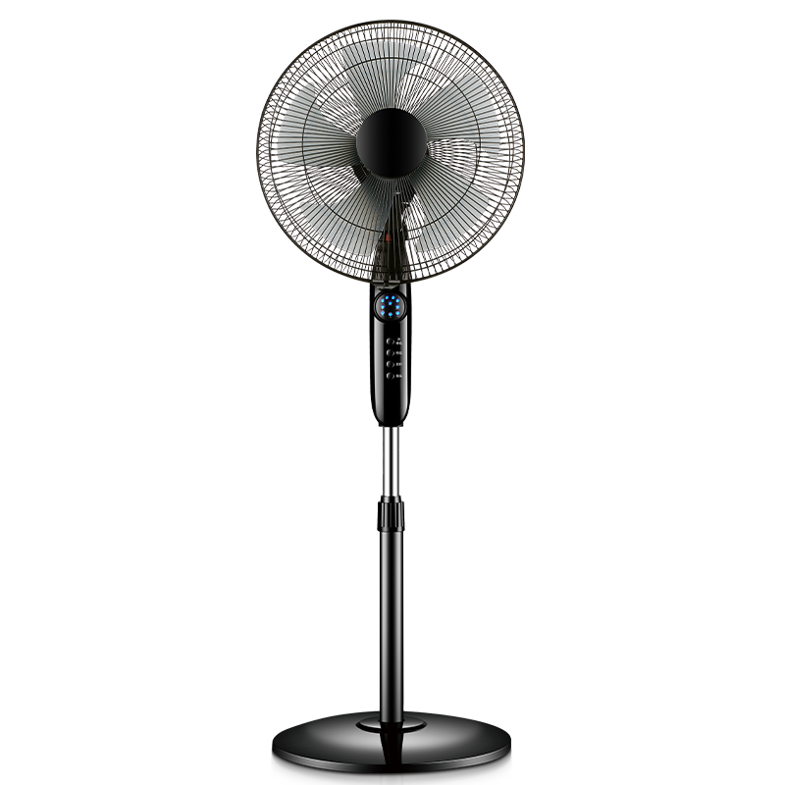
Specifications：16 Inch Floor Fan-FS-35H191(Y)（Customizable）
Product Specifications |  | Customizable | Product Selling Points
Rated Voltage | 220V~50Hz | ✓ | 4 speed levels, remote control
Rated Power | 60W | ✓ | Left & right oscillation
Body Material | Metal & Polypropylene (PP) | ✓ | Adjustable fan height
Product Size | 410*380*1160mm |  | Powerful airflow, quiet operation
Carton Size | 460×180×365 mm |  | Dense safety grill protection
Control Mode | Remote control operation | ✓ | Stable base with counterweight
Packing Qty. | 1 pcs/ctn | ✓ | 7.5-hour timing function
Blade Quantity | 5 Plastic Blades |  | OEM & ODM supported
Oscillation | Left & Right Oscillation |  | Carton color is customizable
Packing Data |  | Packing Quantity（pcs ）
Specifications | G.W /N.W(KG) | 20GP | 40GP | 40HQ
16 Inch Floor Fan | 4.9/4.1 | 719 | 1582 | 1955

Slide 17
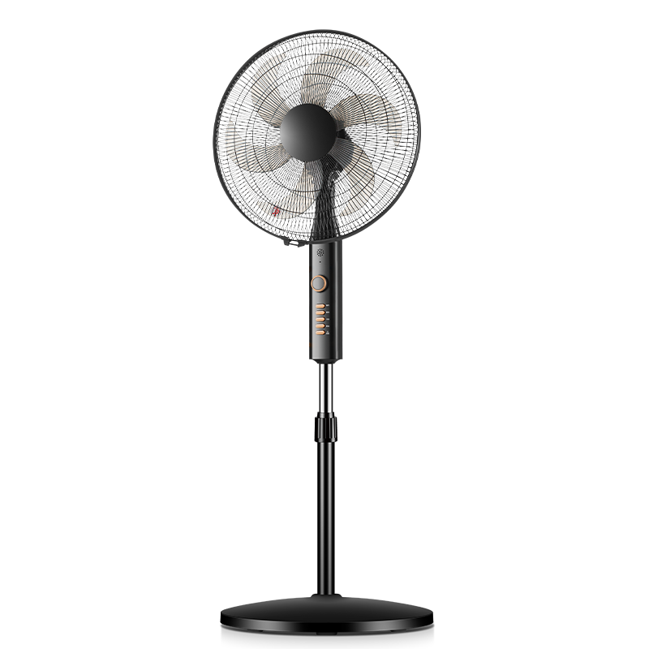
Specifications：18 Inch Floor Fan-FD-40L261（Customizable）
Product Specifications |  | Customizable | Product Selling Points
Rated Voltage | 220V~50Hz | ✓ | 4-speed rotary knob control
Rated Power | 60W | ✓ | Left & right oscillation+1-hour timer
Body Material | Metal & Polypropylene (PP) | ✓ | Adjustable fan height
Product Size | 450*420*1420mm |  | Powerful airflow, quiet operation
Carton Size | 540*210*490mm |  | Dense safety grill protection
Control Mode | Rotary Knob Control | ✓ | Stable base with counterweight
Packing Qty. | 1 pcs/ctn | ✓ | Customizable colors
Blade Quantity | 6 Plastic Blades |  | OEM & ODM supported
Oscillation | Left & Right Oscillation |  | Carton color is customizable
Packing Data |  | Packing Quantity（pcs ）
Specifications | G.W /N.W(KG) | 20GP | 40GP | 40HQ
18Inch Floor Fan | 6.5/5.4 | 450 | 990 | 1224

Slide 18
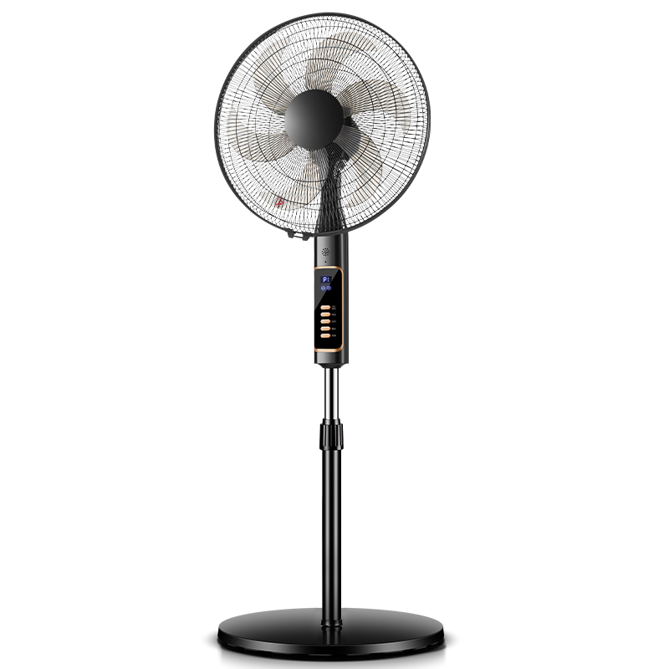
Specifications：18 Inch Floor Fan-FD-40L261Y（Customizable）
Product Specifications |  | Customizable | Product Selling Points
Rated Voltage | 220V~50Hz | ✓ | 4 speed levels, remote control
Rated Power | 60W | ✓ | Left & right oscillation+24-hour timer
Body Material | Metal & Polypropylene (PP) | ✓ | Adjustable fan height
Product Size | 450*420*1420mm |  | Powerful airflow, quiet operation
Carton Size | 540*210*490mm |  | Dense safety grill protection
Control Mode | Remote control operation | ✓ | Stable base with counterweight
Packing Qty. | 1 pcs/ctn | ✓ | Customizable colors
Blade Quantity | 6 Plastic Blades |  | OEM & ODM supported
Oscillation | Left & Right Oscillation |  | Carton color is customizable
Packing Data |  | Packing Quantity（pcs ）
Specifications | G.W /N.W(KG) | 20GP | 40GP | 40HQ
18Inch Floor Fan | 6.5/5.4 | 450 | 990 | 1224

Slide 19
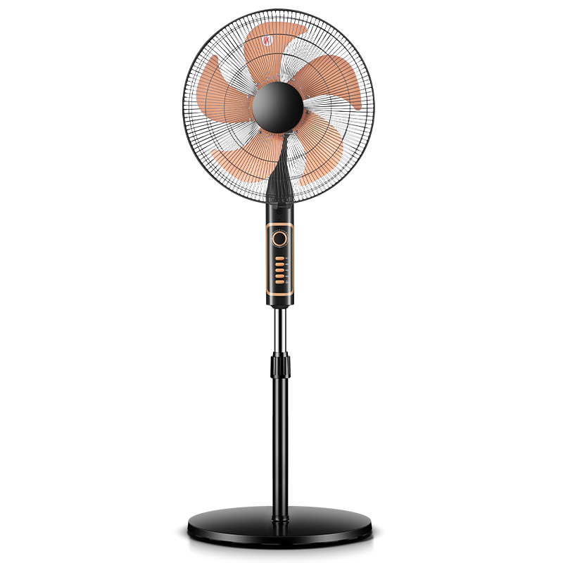
Specifications：18 Inch Floor Fan-FSD-1601B（Customizable）
Product Specifications |  | Customizable | Product Selling Points
Rated Voltage | 220V~50Hz | ✓ | 4-speed rotary knob control
Rated Power | 60W | ✓ | Left & right oscillation+1-hour timer
Body Material | Metal & Polypropylene (PP) | ✓ | Adjustable fan height
Product Size | 450*420*1420mm |  | Powerful airflow, quiet operation
Carton Size | 540*210*490mm |  | Dense safety grill protection
Control Mode | Rotary Knob Control | ✓ | Stable base with counterweight
Packing Qty. | 1 pcs/ctn | ✓ | Customizable colors
Blade Quantity | 5 aluminum blades |  | OEM & ODM supported
Oscillation | Left & Right Oscillation |  | Carton color is customizable
Packing Data |  | Packing Quantity（pcs ）
Specifications | G.W /N.W(KG) | 20GP | 40GP | 40HQ
18Inch Floor Fan | 6.5/5.4 | 450 | 990 | 1224

Slide 20
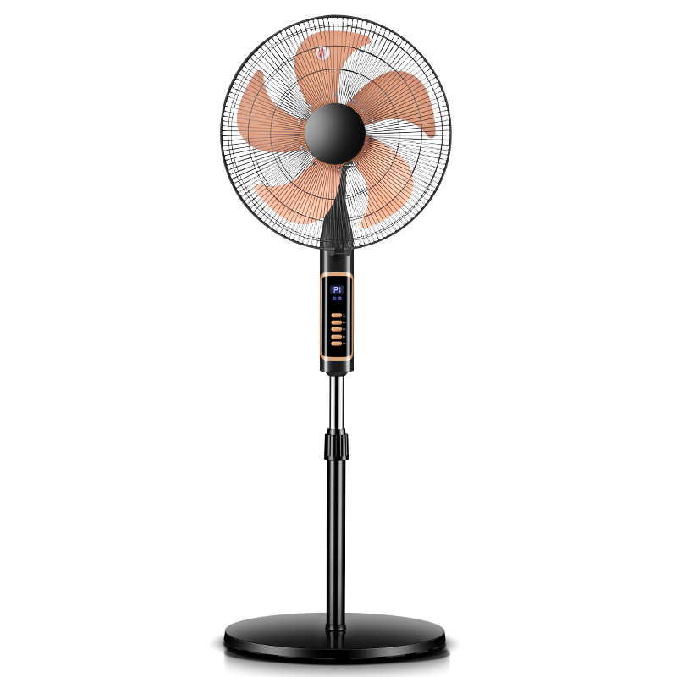
Specifications：18 Inch Floor Fan-FSD-1601BE（Customizable）
Product Specifications |  | Customizable | Product Selling Points
Rated Voltage | 220V~50Hz | ✓ | 4 speed levels, remote control
Rated Power | 60W | ✓ | Left & right oscillation+24-hour timer
Body Material | Metal & Polypropylene (PP) | ✓ | Adjustable fan height
Product Size | 450*420*1420mm |  | Powerful airflow, quiet operation
Carton Size | 540*210*490mm |  | Dense safety grill protection
Control Mode | Remote control operation | ✓ | Stable base with counterweight
Packing Qty. | 1 pcs/ctn | ✓ | Customizable colors
Blade Quantity | 5 aluminum blades |  | OEM & ODM supported
Oscillation | Left & Right Oscillation |  | Carton color is customizable
Packing Data |  | Packing Quantity（pcs ）
Specifications | G.W /N.W(KG) | 20GP | 40GP | 40HQ
18Inch Floor Fan | 6.5/5.4 | 450 | 990 | 1224

Slide 21
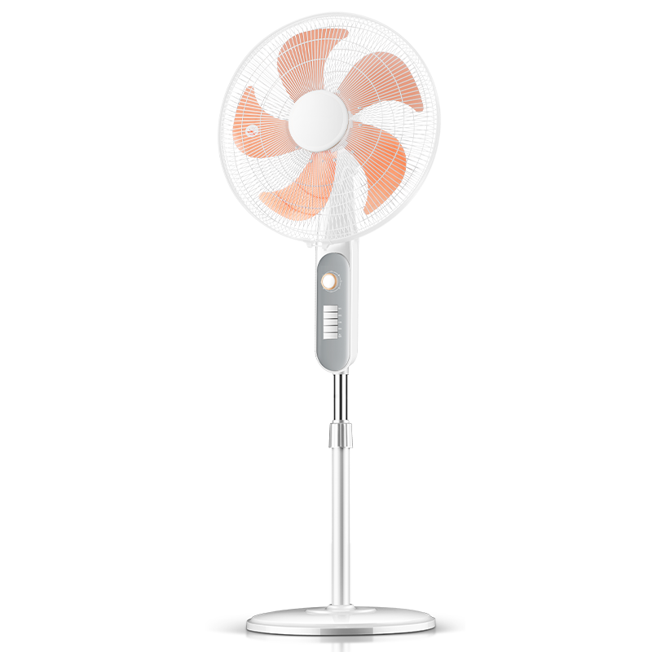
Specifications：20 Inch Floor Fan-FSD-1821B（Customizable）
Product Specifications |  | Customizable | Product Selling Points
Rated Voltage | 220V~50Hz | ✓ | 4-speed rotary knob control
Rated Power | 60W | ✓ | Left & right oscillation+1-hour timer
Body Material | Metal & Polypropylene (PP) | ✓ | Adjustable fan height
Product Size | 502*420*1450mm |  | Powerful airflow, quiet operation
Carton Size | 540*250*510mm |  | Dense safety grill protection
Control Mode | Rotary Knob Control | ✓ | Stable base with counterweight
Packing Qty. | 1 pcs/ctn | ✓ | Customizable colors
Blade Quantity | 5 aluminum blades |  | OEM & ODM supported
Oscillation | Left & Right Oscillation |  | Carton color is customizable
Packing Data |  | Packing Quantity（pcs ）
Specifications | G.W /N.W(KG) | 20GP | 40GP | 40HQ
20Inch Floor Fan | 6.9/5.7 | 413 | 909 | 1124

Slide 22
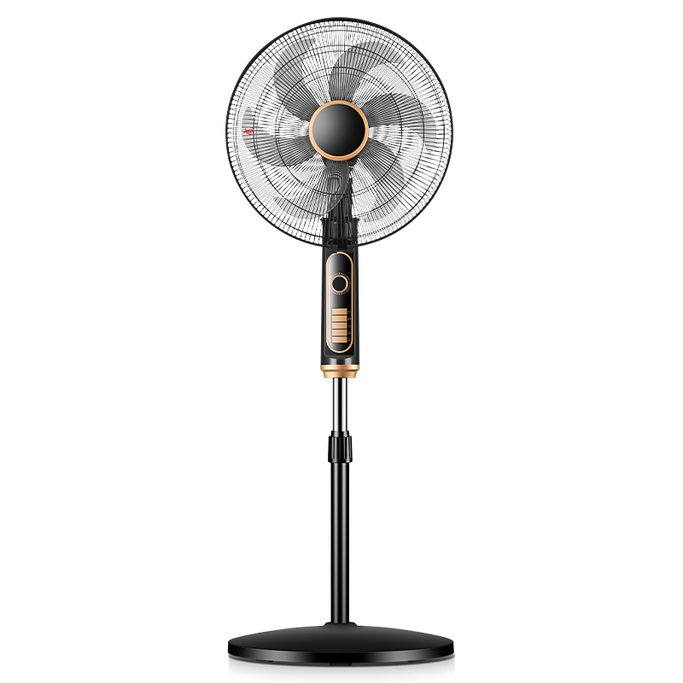
Specifications：20 Inch Floor Fan-FSD-1823A（Customizable）
Product Specifications |  | Customizable | Product Selling Points
Rated Voltage | 220V~50Hz | ✓ | 4-speed rotary knob control
Rated Power | 60W | ✓ | Left & right oscillation+2-hour timer
Body Material | Metal & Polypropylene (PP) | ✓ | Adjustable fan height
Product Size | 502*420*1450mm |  | Powerful airflow, quiet operation
Carton Size | 540*250*510mm |  | Dense safety grill protection
Control Mode | Rotary Knob Control | ✓ | Stable base with counterweight
Packing Qty. | 1 pcs/ctn | ✓ | Customizable colors
Blade Quantity | 6 Plastic Blades |  | OEM & ODM supported
Oscillation | Left & Right Oscillation |  | Carton color is customizable
Packing Data |  | Packing Quantity（pcs ）
Specifications | G.W /N.W(KG) | 20GP | 40GP | 40HQ
20Inch Floor Fan | 6.9/5.7 | 413 | 909 | 1124

Slide 23
Specifications：20 Inch Floor Fan-FD-45L31（Customizable）
Product Specifications |  | Customizable | Product Selling Points
Rated Voltage | 220V~50Hz | ✓ | 4-speed rotary knob control
Rated Power | 60W | ✓ | Left & right oscillation+1-hour timer
Body Material | Metal & Polypropylene (PP) | ✓ | Adjustable fan height
Product Size | 502*420*1450mm |  | Powerful airflow, quiet operation
Carton Size | 540*250*510mm |  | Dense safety grill protection
Control Mode | Rotary Knob Control | ✓ | Stable base with counterweight
Packing Qty. | 1 pcs/ctn | ✓ | Customizable colors
Blade Quantity | 6 Plastic Blades |  | OEM & ODM supported
Oscillation | Left & Right Oscillation |  | Carton color is customizable
Packing Data |  | Packing Quantity（pcs ）
Specifications | G.W /N.W(KG) | 20GP | 40GP | 40HQ
20Inch Floor Fan | 6.9/5.7 | 413 | 909 | 1124

Slide 24
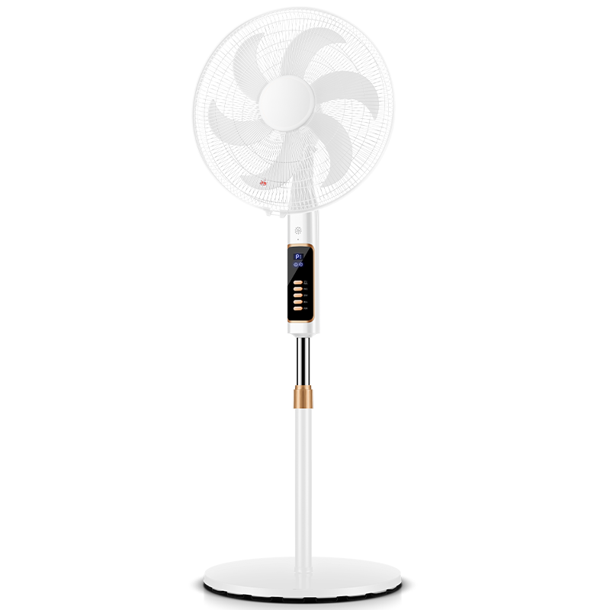
Specifications：20 Inch Floor Fan-FD-45Y31（Customizable）
Product Specifications |  | Customizable | Product Selling Points
Rated Voltage | 220V~50Hz | ✓ | 4 speed levels, remote control
Rated Power | 60W | ✓ | Left & right oscillation+24-hour timer
Body Material | Metal & Polypropylene (PP) | ✓ | Adjustable fan height
Product Size | 500*420*1420mm |  | Powerful airflow, quiet operation
Carton Size | 540*250*510mm |  | Dense safety grill protection
Control Mode | Remote control operation | ✓ | Stable base with counterweight
Packing Qty. | 1 pcs/ctn | ✓ | Customizable colors
Blade Quantity | 6 Plastic Blades |  | OEM & ODM supported
Oscillation | Left & Right Oscillation |  | Carton color is customizable
Packing Data |  | Packing Quantity（pcs ）
Specifications | G.W /N.W(KG) | 20GP | 40GP | 40HQ
20Inch Floor Fan | 6.9/5.7 | 413 | 909 | 1124

Slide 25
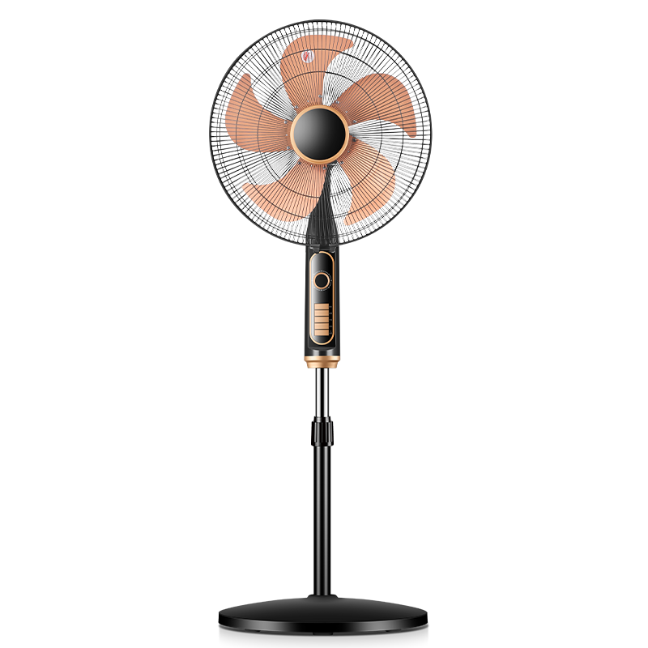
Specifications：20 Inch Floor Fan-FSD-1823B（Customizable）
Product Specifications |  | Customizable | Product Selling Points
Rated Voltage | 220V~50Hz | ✓ | 4-speed rotary knob control
Rated Power | 60W | ✓ | Left & right oscillation+2-hour timer
Body Material | Metal & Polypropylene (PP) | ✓ | Adjustable fan height
Product Size | 502*420*1450mm |  | Powerful airflow, quiet operation
Carton Size | 540*250*510mm |  | Dense safety grill protection
Control Mode | Rotary Knob Control | ✓ | Stable base with counterweight
Packing Qty. | 1 pcs/ctn | ✓ | Customizable colors
Blade Quantity | 5 aluminum blades |  | OEM & ODM supported
Oscillation | Left & Right Oscillation |  | Carton color is customizable
Packing Data |  | Packing Quantity（pcs ）
Specifications | G.W /N.W(KG) | 20GP | 40GP | 40HQ
20Inch Floor Fan | 6.9/5.7 | 413 | 909 | 1124

Slide 26
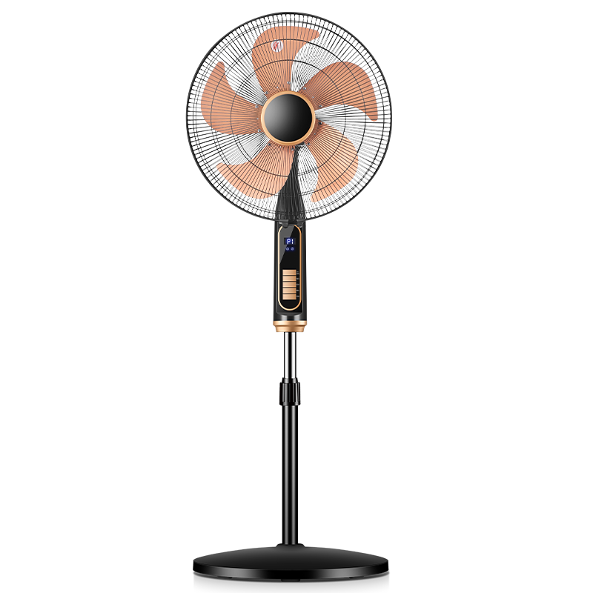
Specifications：20 Inch Floor Fan-FSD-1823BE（Customizable）
Product Specifications |  | Customizable | Product Selling Points
Rated Voltage | 220V~50Hz | ✓ | 4 speed levels, remote control
Rated Power | 60W | ✓ | Left & right oscillation+24-hour timer
Body Material | Metal & Polypropylene (PP) | ✓ | Adjustable fan height
Product Size | 500*420*1420mm |  | Powerful airflow, quiet operation
Carton Size | 540*250*510mm |  | Dense safety grill protection
Control Mode | Remote control operation | ✓ | Stable base with counterweight
Packing Qty. | 1 pcs/ctn | ✓ | Customizable colors
Blade Quantity | 5 aluminum blades |  | OEM & ODM supported
Oscillation | Left & Right Oscillation |  | Carton color is customizable
Packing Data |  | Packing Quantity（pcs ）
Specifications | G.W /N.W(KG) | 20GP | 40GP | 40HQ
20Inch Floor Fan | 6.9/5.7 | 413 | 909 | 1124

Slide 27
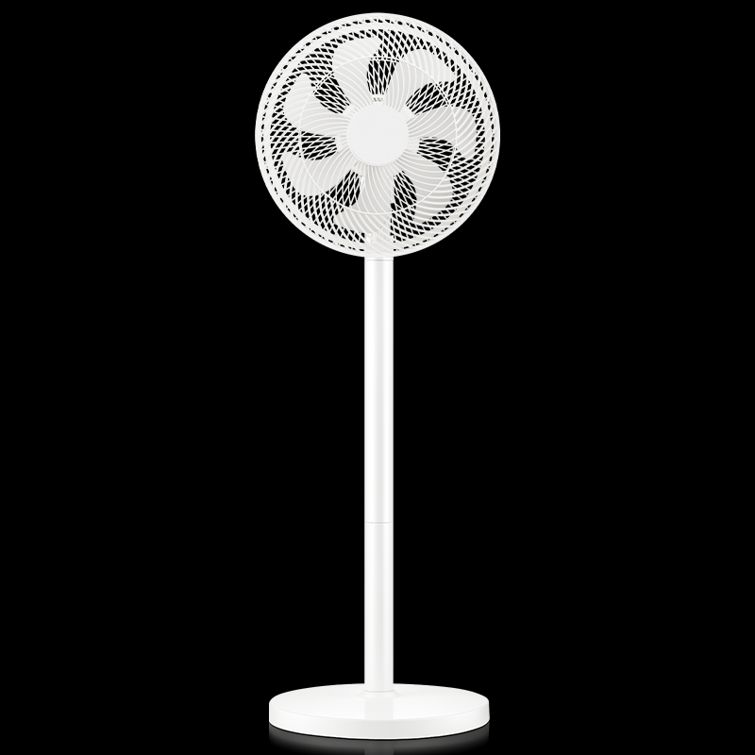
Specifications：12 Inch Floor Fan-RS-FX2401AH（Customizable）
Product Specifications |  | Customizable | Product Selling Points
Rated Voltage | 220V~50Hz | ✓ | 3-speed rotary knob control
Rated Power | 40W | ✓ | Left & right oscillation
Body Material | Polypropylene (PP) | ✓ | Dual use as table or floor fan
Product Size | 305*290*950mm |  | Powerful airflow, quiet operation
Carton Size | 430*175*330mm |  | Dense safety grill protection
Control Mode | Rotary Knob Control | ✓ | Stable base with counterweight
Packing Qty. | 1 pcs/ctn | ✓ | Customizable colors
Blade Quantity | 7 Plastic Blades |  | OEM & ODM supported
Oscillation | Left & Right Oscillation |  | Carton color is customizable
Packing Data |  | Packing Quantity（pcs ）
Specifications | G.W /N.W(KG) | 20GP | 40GP | 40HQ
12Inch Floor Fan | 3.8/3.1 | 1103 | 2427 | 3001

Slide 28
Specifications：12 Inch Floor Fan-RS-FL2401RX（Customizable）
Product Specifications |  | Customizable | Product Selling Points
Rated Voltage | 220V~50Hz | ✓ | 3 speed levels, remote control
Rated Power | 40W | ✓ | Left & right oscillation+9-hour timer
Body Material | Polypropylene (PP) | ✓ | Dual use as table or floor fan
Product Size | 305*290*950mm |  | Powerful airflow, quiet operation
Carton Size | 430*175*330mm |  | Dense safety grill protection
Control Mode | Remote control operation | ✓ | Stable base with counterweight
Packing Qty. | 1 pcs/ctn | ✓ | Customizable colors
Blade Quantity | 7 Plastic Blades |  | OEM & ODM supported
Oscillation | Left & Right Oscillation |  | Carton color is customizable
Packing Data |  | Packing Quantity（pcs ）
Specifications | G.W /N.W(KG) | 20GP | 40GP | 40HQ
12Inch Floor Fan | 3.8/3.1 | 1103 | 2427 | 3001

Slide 29
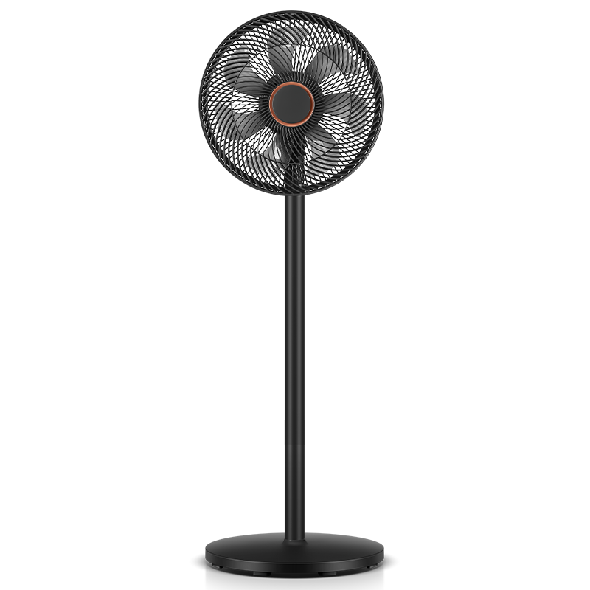
Specifications：14 Inch Floor Fan-FD-30L501（Customizable）
Product Specifications |  | Customizable | Product Selling Points
Rated Voltage | 220V~50Hz | ✓ | 3-speed rotary knob control
Rated Power | 60W | ✓ | Left & right oscillation
Body Material | Polypropylene (PP) | ✓ | Dual use as table or floor fan
Product Size | 360*360*1100mm |  | Powerful airflow, quiet operation
Carton Size | 500*170*370mm |  | Dense safety grill protection
Control Mode | Rotary Knob Control | ✓ | Stable base with counterweight
Packing Qty. | 1 pcs/ctn | ✓ | Customizable colors
Blade Quantity | 7 Plastic Blades |  | OEM & ODM supported
Oscillation | Left & Right Oscillation |  | Carton color is customizable
Packing Data |  | Packing Quantity（pcs ）
Specifications | G.W /N.W(KG) | 20GP | 40GP | 40HQ
14Inch Floor Fan | 4.7/4.2 | 795 | 1749 | 2162

Slide 30
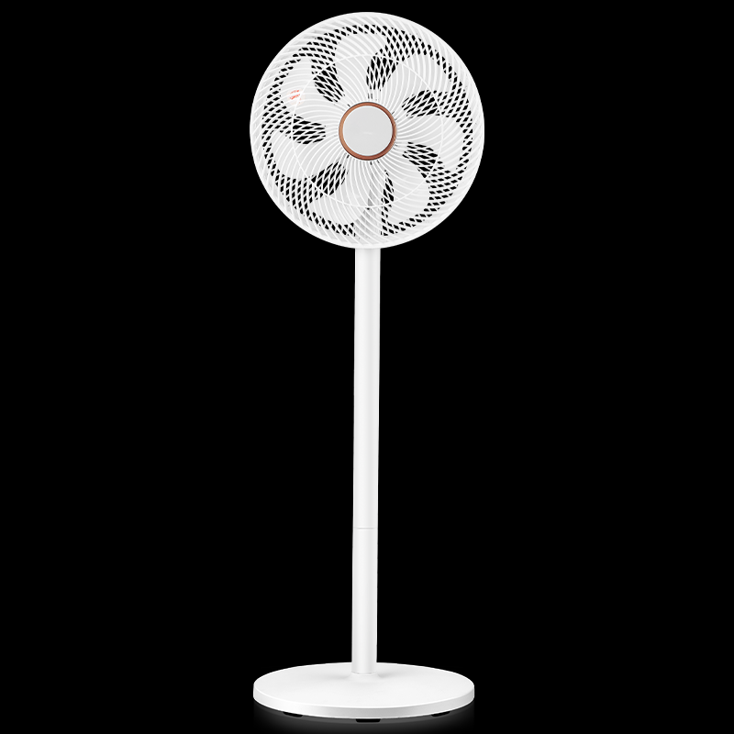
Specifications：14 Inch Floor Fan-FD-30Y501（Customizable）
Product Specifications |  | Customizable | Product Selling Points
Rated Voltage | 220V~50Hz | ✓ | 3 speed levels, remote control
Rated Power | 60W | ✓ | Left & right oscillation+7-hour timer
Body Material | Polypropylene (PP) | ✓ | Dual use as table or floor fan
Product Size | 360*360*1100mm |  | Powerful airflow, quiet operation
Carton Size | 500*170*370mm |  | Dense safety grill protection
Control Mode | Remote control operation | ✓ | Stable base with counterweight
Packing Qty. | 1 pcs/ctn | ✓ | Customizable colors
Blade Quantity | 7 Plastic Blades |  | OEM & ODM supported
Oscillation | Left & Right Oscillation |  | Carton color is customizable
Packing Data |  | Packing Quantity（pcs ）
Specifications | G.W /N.W(KG) | 20GP | 40GP | 40HQ
14nch Floor Fan | 4.7/4.2 | 795 | 1749 | 2162

Slide 31
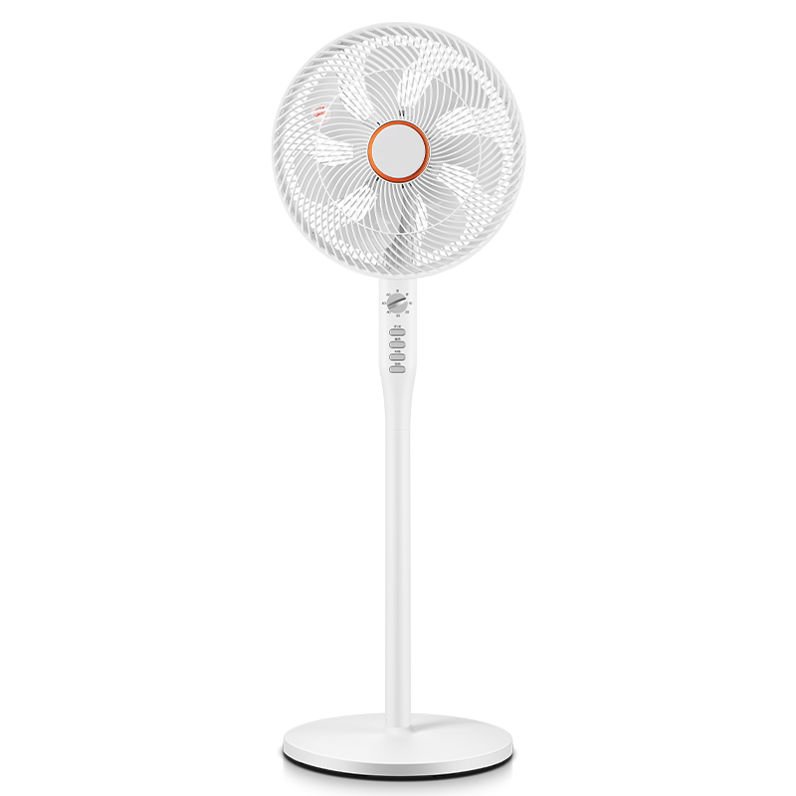
Specifications：14 Inch Floor Fan-FD-30L503（Customizable）
Product Specifications |  | Customizable | Product Selling Points
Rated Voltage | 220V~50Hz | ✓ | 4-speed rotary knob control
Rated Power | 60W | ✓ | Left & right oscillation
Body Material | Polypropylene (PP) | ✓ | Dual use as table or floor fan
Product Size | 360*360*1100mm |  | Powerful airflow, quiet operation
Carton Size | 520*180*370mm |  | Dense safety grill protection
Control Mode | Rotary Knob Control | ✓ | Stable base with counterweight
Packing Qty. | 1 pcs/ctn | ✓ | Customizable colors
Blade Quantity | 7 Plastic Blades |  | OEM & ODM supported
Oscillation | Left & Right Oscillation |  | Carton color is customizable
Packing Data |  | Packing Quantity（pcs ）
Specifications | G.W /N.W(KG) | 20GP | 40GP | 40HQ
14Inch Floor Fan | 4.7/4.2 | 722 | 1588 | 1964

Slide 32
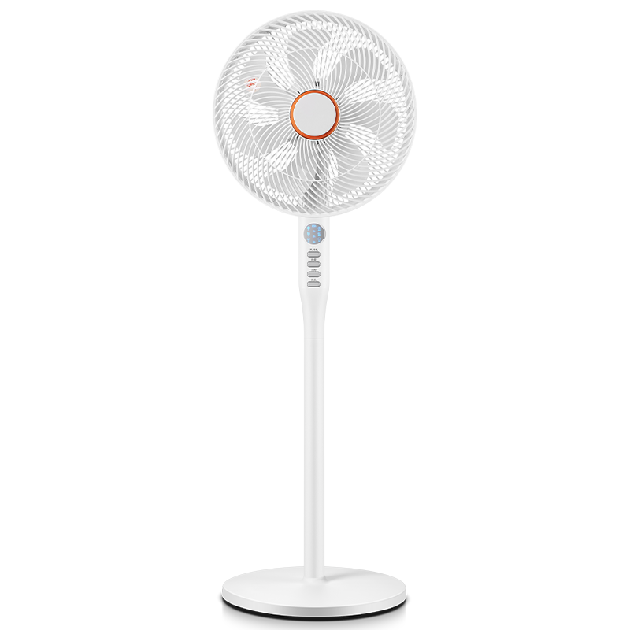
Specifications：14 Inch Floor Fan-FD-30Y506（Customizable）
Product Specifications |  | Customizable | Product Selling Points
Rated Voltage | 220V~50Hz | ✓ | 3 speed levels, remote control
Rated Power | 60W | ✓ | Left & right oscillation+7.5-hour timer
Body Material | Polypropylene (PP) | ✓ | Dual use as table or floor fan
Product Size | 360*360*1100mm |  | Powerful airflow, quiet operation
Carton Size | 520*180*370mm |  | Dense safety grill protection
Control Mode | Remote control operation | ✓ | Stable base with counterweight
Packing Qty. | 1 pcs/ctn | ✓ | Customizable colors
Blade Quantity | 7 Plastic Blades |  | OEM & ODM supported
Oscillation | Left & Right Oscillation |  | Carton color is customizable
Packing Data |  | Packing Quantity（pcs ）
Specifications | G.W /N.W(KG) | 20GP | 40GP | 40HQ
14nch Floor Fan | 4.7/4.2 | 722 | 1588 | 1964

Slide 33
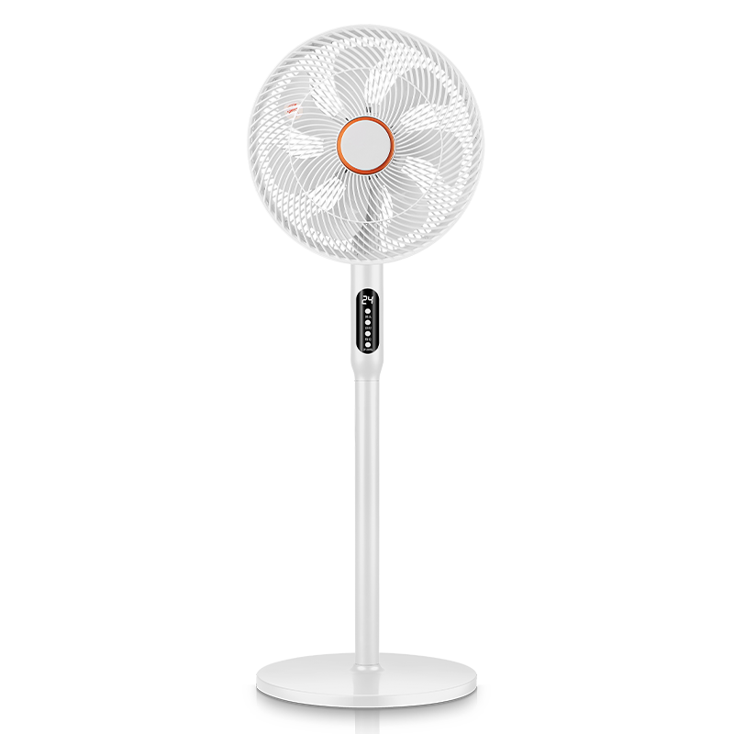
Specifications：14 Inch Floor Fan-FS-35D909(Y)（Customizable）
Product Specifications |  | Customizable | Product Selling Points
Rated Voltage | 220V~50Hz | ✓ | 3-speed rotary knob control
Rated Power | 60W | ✓ | Left & right oscillation+24-hour timer
Body Material | Polypropylene (PP) | ✓ | Dual use as table or floor fan
Product Size | 360*360*1100mm |  | Powerful airflow, quiet operation
Carton Size | 480*200*370mm |  | Dense safety grill protection
Control Mode | Remote control operation | ✓ | Stable base with counterweight
Packing Qty. | 1 pcs/ctn | ✓ | Customizable colors
Blade Quantity | 7 Plastic Blades |  | OEM & ODM supported
Oscillation | Left & Right Oscillation |  | Carton color is customizable
Packing Data |  | Packing Quantity（pcs ）
Specifications | G.W /N.W(KG) | 20GP | 40GP | 40HQ
14nch Floor Fan | 4.7/4.2 | 704 | 1548 | 1914

Slide 34
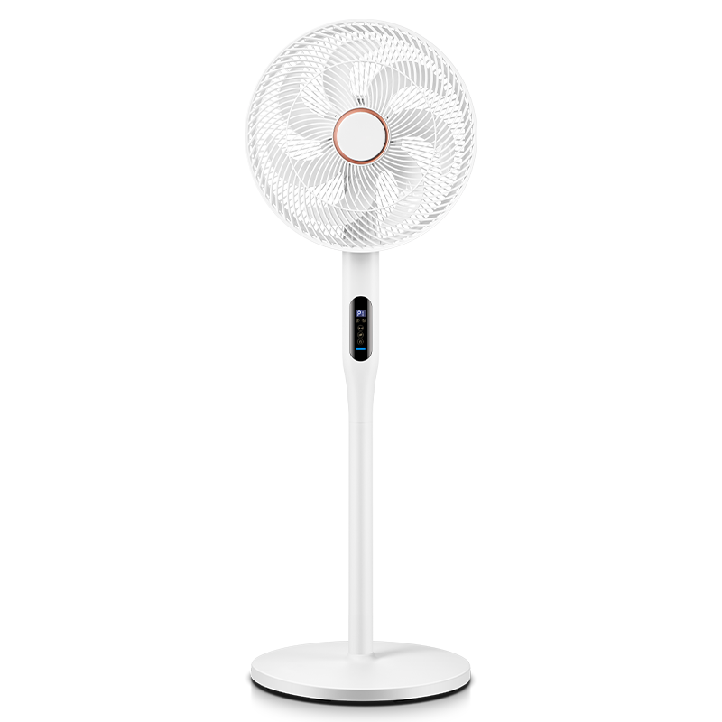
Specifications：14 Inch Floor Fan-FSD-1211E（Customizable）
Product Specifications |  | Customizable | Product Selling Points
Rated Voltage | 220V~50Hz | ✓ | 3 speed levels, remote control
Rated Power | 60W | ✓ | Left & right oscillation+24-hour timer
Body Material | Polypropylene (PP) | ✓ | Dual use as table or floor fan
Product Size | 360*360*1100mm |  | Powerful airflow, quiet operation
Carton Size | 530*200*370mm |  | Dense safety grill protection
Control Mode | Remote control operation | ✓ | Stable base with counterweight
Packing Qty. | 1 pcs/ctn | ✓ | Customizable colors
Blade Quantity | 7 Plastic Blades |  | OEM & ODM supported
Oscillation | Left & Right Oscillation |  | Carton color is customizable
Packing Data |  | Packing Quantity（pcs ）
Specifications | G.W /N.W(KG) | 20GP | 40GP | 40HQ
14nch Floor Fan | 4.7/4.2 | 637 | 1402 | 1734

Slide 35
Specifications：14 DC motor floor fan-FDZ-30Y03（Customizable）
Product Specifications |  | Customizable | Product Selling Points
Rated Voltage | 220V~50Hz | ✓ | 32 speed levels, remote control
Rated Power | 30W | ✓ | Left & right oscillation+24-hour timer
Body Material | Polypropylene (PP) | ✓ | Dual use as table or floor fan
Product Size | 360*360*1100mm |  | Powerful airflow, quiet operation
Carton Size | 530*200*370mm |  | Dense safety grill protection
Control Mode | Remote control operation | ✓ | Stable base with counterweight
Packing Qty. | 1 pcs/ctn | ✓ | Customizable colors
Blade Quantity | 7 Plastic Blades |  | OEM & ODM supported
Oscillation | Left & Right Oscillation |  | Carton color is customizable
Packing Data |  | Packing Quantity（pcs ）
Specifications | G.W /N.W(KG) | 20GP | 40GP | 40HQ
14nch Floor Fan | 4.7/4.2 | 637 | 1402 | 1734

Slide 36
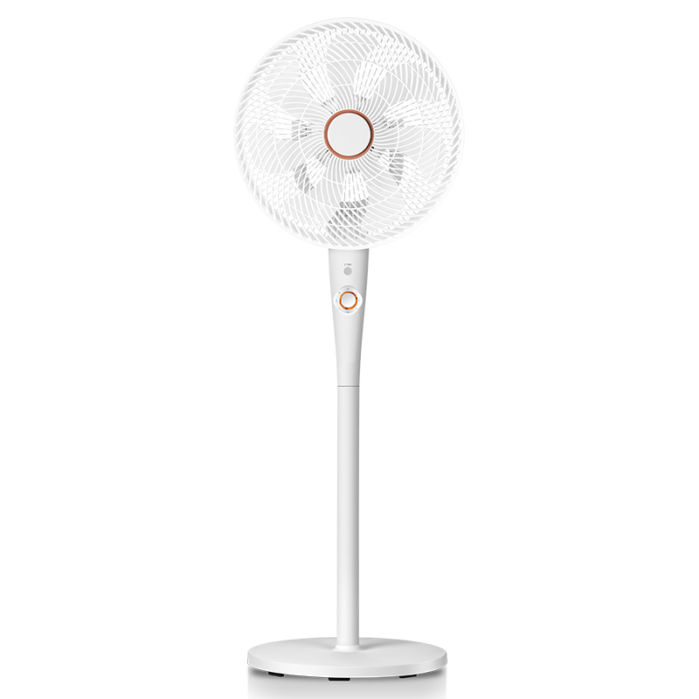
Specifications：14 Inch Floor Fan-FSD-3501（Customizable）
Product Specifications |  | Customizable | Product Selling Points
Rated Voltage | 220V~50Hz | ✓ | 3-speed rotary knob control
Rated Power | 60W | ✓ | 3D Wide-angle Oscillation
Body Material | Polypropylene (PP) | ✓ | Dual use as table or floor fan
Product Size | 400*400*1200mm |  | Powerful airflow, quiet operation
Carton Size | 580*355*425mm |  | Dense safety grill protection
Control Mode | Rotary Knob Control | ✓ | Stable base with counterweight
Packing Qty. | 1 pcs/ctn | ✓ | Customizable colors
Blade Quantity | 7 Plastic Blades |  | OEM & ODM supported
Oscillation | Left & Right Oscillation |  | Carton color is customizable
Packing Data |  | Packing Quantity（pcs ）
Specifications | G.W /N.W(KG) | 20GP | 40GP | 40HQ
14Inch Floor Fan | 5.7/4.9 | 286 | 629 | 777

Slide 37
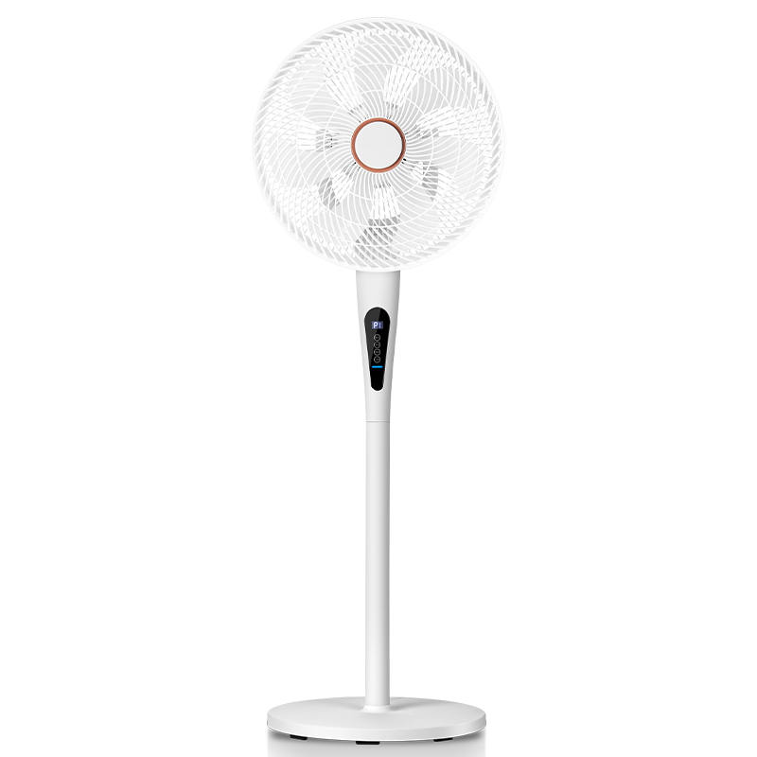
Specifications：14 Inch Floor Fan-FSD-3501E（Customizable）
Product Specifications |  | Customizable | Product Selling Points
Rated Voltage | 220V~50Hz | ✓ | 6 speed levels, remote control
Rated Power | 60W | ✓ | 3D Wide-angle Oscillation+24-hour timer
Body Material | Polypropylene (PP) | ✓ | Dual use as table or floor fan
Product Size | 400*400*1200mm |  | Powerful airflow, quiet operation
Carton Size | 580*355*425mm |  | Dense safety grill protection
Control Mode | Remote control operation | ✓ | Stable base with counterweight
Packing Qty. | 1 pcs/ctn | ✓ | Customizable colors
Blade Quantity | 7 Plastic Blades |  | OEM & ODM supported
Oscillation | Left & Right Oscillation |  | Carton color is customizable
Packing Data |  | Packing Quantity（pcs ）
Specifications | G.W /N.W(KG) | 20GP | 40GP | 40HQ
14Inch Floor Fan | 5.7/4.9 | 286 | 629 | 777

Slide 38
Specifications：14 DC motor floor fan-FDZ-35Y06（Customizable）
Product Specifications |  | Customizable | Product Selling Points
Rated Voltage | 220V~50Hz | ✓ | 24 speed levels, remote control
Rated Power | 30W | ✓ | 3D Wide-angle Oscillation+24-hour timer
Body Material | Polypropylene (PP) | ✓ | Dual use as table or floor fan
Product Size | 400*400*1200mm |  | Powerful airflow, quiet operation
Carton Size | 580*355*425mm |  | Dense safety grill protection
Control Mode | Remote control operation | ✓ | Stable base with counterweight
Packing Qty. | 1 pcs/ctn | ✓ | Customizable colors
Blade Quantity | 7 Plastic Blades |  | OEM & ODM supported
Oscillation | Left & Right Oscillation |  | Carton color is customizable
Packing Data |  | Packing Quantity（pcs ）
Specifications | G.W /N.W(KG) | 20GP | 40GP | 40HQ
14Inch Floor Fan | 5.7/4.9 | 286 | 629 | 777

Slide 39
Specifications：14 DC motor floor fan-RS-26FS24H（Customizable）
Product Specifications |  | Customizable | Product Selling Points
Rated Voltage | 220V~50Hz | ✓ | Stepless Speed Control
Rated Power | 25W | ✓ | Left & right oscillation
Body Material | Polypropylene (PP) | ✓ | Dual use as table or floor fan
Product Size | 360*360*1100mm |  | Powerful airflow, quiet operation
Carton Size | 500*170*370mm |  | Dense safety grill protection
Control Mode | Rotary Knob Control | ✓ | Stable base with counterweight
Packing Qty. | 1 pcs/ctn | ✓ | Customizable colors
Blade Quantity | 7 Plastic Blades |  | OEM & ODM supported
Oscillation | Left & Right Oscillation |  | Carton color is customizable
Packing Data |  | Packing Quantity（pcs ）
Specifications | G.W /N.W(KG) | 20GP | 40GP | 40HQ
14Inch Floor Fan | 4.7/4.2 | 795 | 1749 | 2162

Slide 40
Specifications：14 DC motor floor fan-RS-26FS24YH（Customizable）
Product Specifications |  | Customizable | Product Selling Points
Rated Voltage | 220V~50Hz | ✓ | 24 speed levels, remote control
Rated Power | 30W | ✓ | Left & right oscillation+24-hour timer
Body Material | Polypropylene (PP) | ✓ | Dual use as table or floor fan
Product Size | 360*360*1100mm |  | Powerful airflow, quiet operation
Carton Size | 500*170*370mm |  | Dense safety grill protection
Control Mode | Remote control operation | ✓ | Stable base with counterweight
Packing Qty. | 1 pcs/ctn | ✓ | Customizable colors
Blade Quantity | 7 Plastic Blades |  | OEM & ODM supported
Oscillation | Left & Right Oscillation |  | Carton color is customizable
Packing Data |  | Packing Quantity（pcs ）
Specifications | G.W /N.W(KG) | 20GP | 40GP | 40HQ
14nch Floor Fan | 4.7/4.2 | 795 | 1749 | 2162

Slide 41
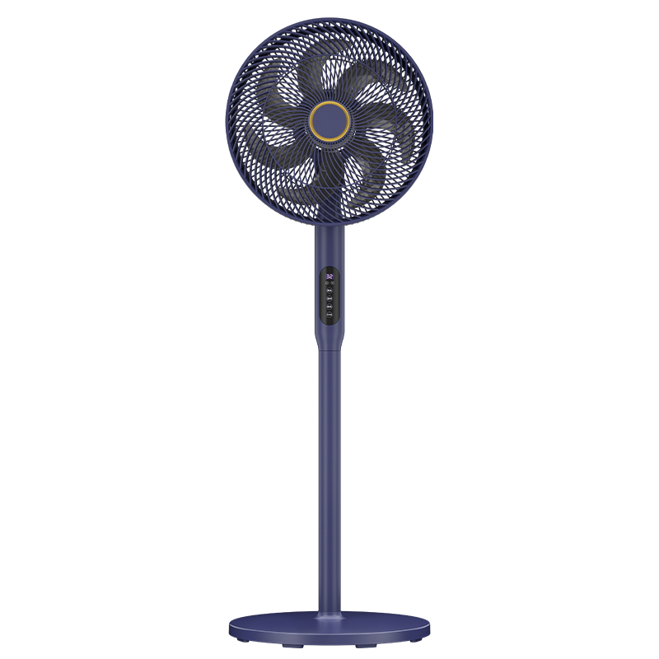
Specifications：14 DC motor floor fan-FS-30H2X1(Y)（Customizable）
Product Specifications |  | Customizable | Product Selling Points
Rated Voltage | 220V~50Hz | ✓ | 24 speed levels, remote control
Rated Power | 30W | ✓ | Left & right oscillation+24-hour timer
Body Material | Polypropylene (PP) | ✓ | Dual use as table or floor fan
Product Size | 360*360*1100mm |  | Powerful airflow, quiet operation
Carton Size | 480*200*370mm |  | Dense safety grill protection
Control Mode | Remote control operation | ✓ | Stable base with counterweight
Packing Qty. | 1 pcs/ctn | ✓ | Customizable colors
Blade Quantity | 7 Plastic Blades |  | OEM & ODM supported
Oscillation | Left & Right Oscillation |  | Carton color is customizable
Packing Data |  | Packing Quantity（pcs ）
Specifications | G.W /N.W(KG) | 20GP | 40GP | 40HQ
14nch Floor Fan | 4.7/4.2 | 704 | 1548 | 1914

Slide 42
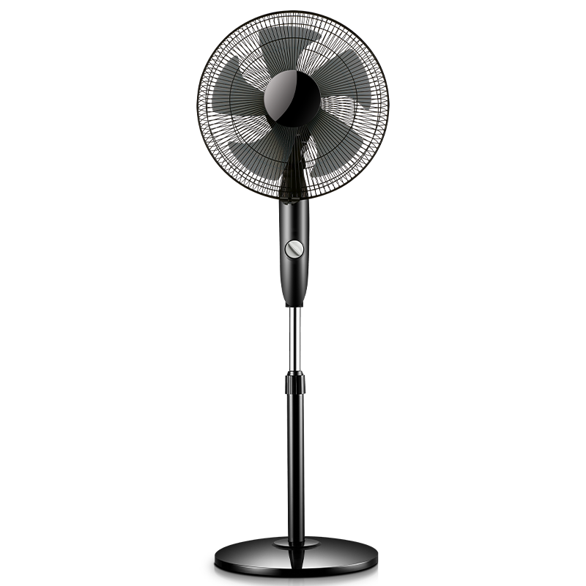
Specifications：16DC motor floor fan-FD-35L207（Customizable）
Product Specifications |  | Customizable | Product Selling Points
Rated Voltage | 220V~50Hz | ✓ | Stepless Speed Control
Rated Power | 25W | ✓ | Left & right oscillation
Body Material | Polypropylene (PP) | ✓ | Adjustable fan height
Product Size | 420*380*1160mm |  | Powerful airflow, quiet operation
Carton Size | 460×180×365 mm |  | Dense safety grill protection
Control Mode | Rotary Knob Control | ✓ | Stable base with counterweight
Packing Qty. | 1 pcs/ctn | ✓ | Customizable colors
Blade Quantity | 7 Plastic Blades |  | OEM & ODM supported
Oscillation | Left & Right Oscillation |  | Carton color is customizable
Packing Data |  | Packing Quantity（pcs ）
Specifications | G.W /N.W(KG) | 20GP | 40GP | 40HQ
16Inch Floor Fan | 4.8/3.6 | 681 | 1498 | 1852

Slide 43
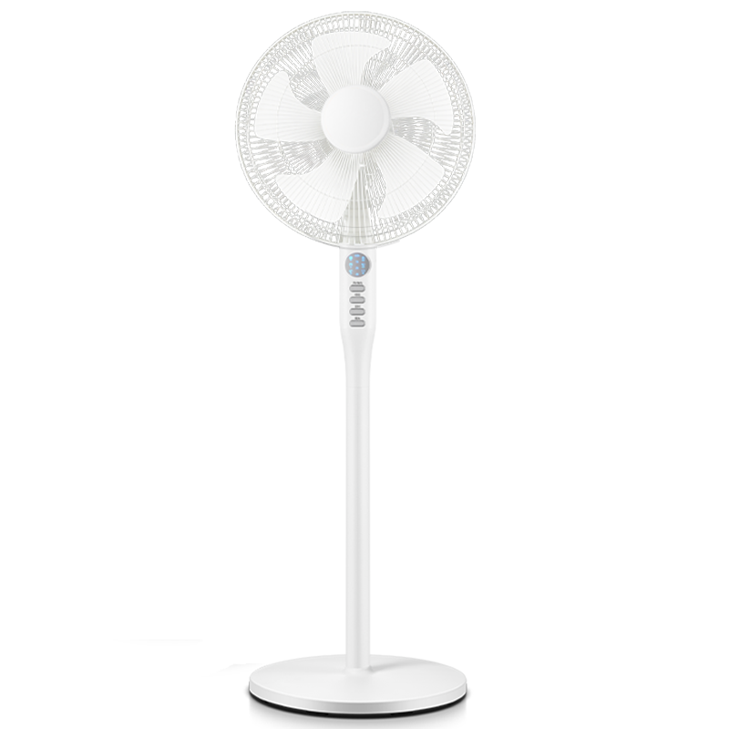
Specifications：16 DC motor floor fan-FD-30Z501（Customizable）
Product Specifications |  | Customizable | Product Selling Points
Rated Voltage | 220V~50Hz | ✓ | 24 speed levels, remote control
Rated Power | 30W | ✓ | Left & right oscillation+24-hour timer
Body Material | Polypropylene (PP) | ✓ | Adjustable fan height
Product Size | 420*380*1160mm |  | Powerful airflow, quiet operation
Carton Size | 460×180×365 mm |  | Dense safety grill protection
Control Mode | Remote control operation | ✓ | Stable base with counterweight
Packing Qty. | 1 pcs/ctn | ✓ | Customizable colors
Blade Quantity | 7 Plastic Blades |  | OEM & ODM supported
Oscillation | Left & Right Oscillation |  | Carton color is customizable
Packing Data |  | Packing Quantity（pcs ）
Specifications | G.W /N.W(KG) | 20GP | 40GP | 40HQ
16Inch Floor Fan | 4.8/3.6 | 681 | 1498 | 1852

Slide 44
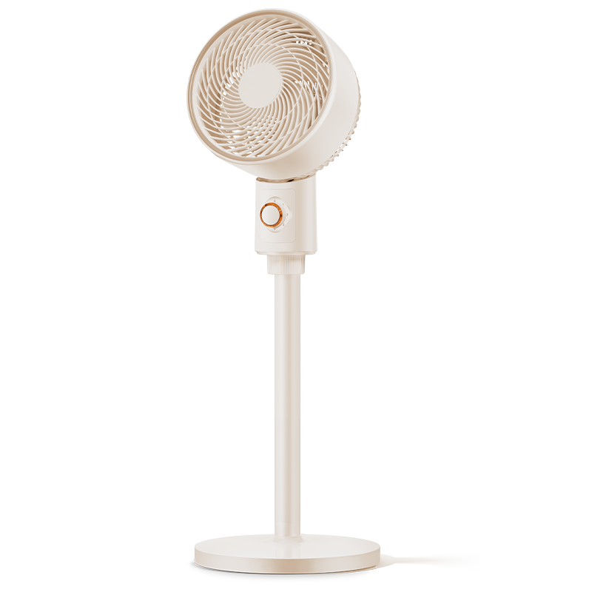
Specifications：Vertical Air Circulator Fan-FX581
Product Specifications |  | Customizable | Product Selling Points
Rated Voltage | 220V~50Hz | ✓ | 3-speed rotary knob control
Rated Power | 35W | ✓ | Left & right oscillation
Body Material | Polypropylene (PP) | ✓ | Dual use as table or floor fan
Product Size | 300*260*1030mm |  | Powerful airflow, quiet operation
Carton Size | 305*259*395mm |  | Dense safety grill protection
Control Mode | Rotary Knob Control | ✓ | Stable base with counterweight
Packing Qty. | 1 pcs/ctn | ✓ | Customizable colors
Blade Quantity | 3 Plastic Blades |  | OEM & ODM supported
Oscillation | Left & Right Oscillation |  | Carton color is customizable
Packing Data |  | Packing Quantity（pcs ）
Specifications | G.W /N.W(KG) | 20GP | 40GP | 40HQ
Vertical Air Circulator Fan | 4/3.1 | 830 | 1826 | 2258

Slide 45
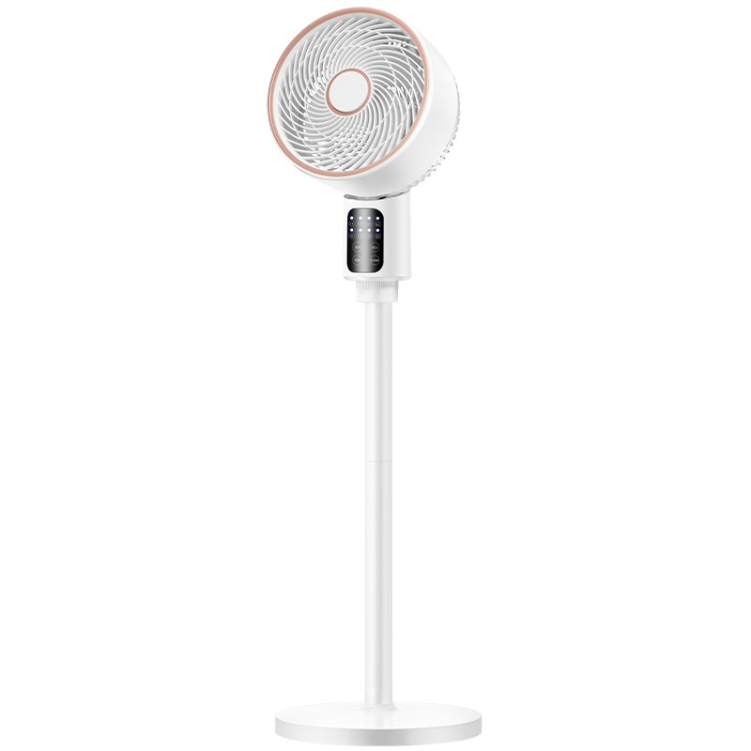
Specifications：Vertical Air Circulator Fan-FX581D
Product Specifications |  | Customizable | Product Selling Points
Rated Voltage | 220V~50Hz | ✓ | 3 speed levels, remote control
Rated Power | 35W | ✓ | Left & right oscillation+7.5-hour timer
Body Material | Polypropylene (PP) | ✓ | Dual use as table or floor fan
Product Size | 300*260*1030mm |  | Powerful airflow, quiet operation
Carton Size | 305*259*395mm |  | Dense safety grill protection
Control Mode | Remote control operation | ✓ | Stable base with counterweight
Packing Qty. | 1 pcs/ctn | ✓ | Customizable colors
Blade Quantity | 3 Plastic Blades |  | OEM & ODM supported
Oscillation | Left & Right Oscillation |  | Carton color is customizable
Packing Data |  | Packing Quantity（pcs ）
Specifications | G.W /N.W(KG) | 20GP | 40GP | 40HQ
Vertical Air Circulator Fan | 4/3.1 | 830 | 1826 | 2258

Slide 46
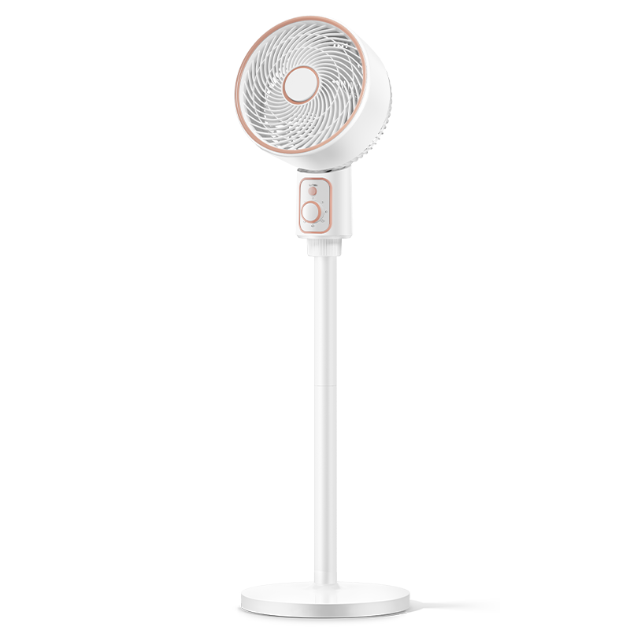
Specifications：Vertical Air Circulator Fan-FXL163
Product Specifications |  | Customizable | Product Selling Points
Rated Voltage | 220V~50Hz | ✓ | 3-speed rotary knob control
Rated Power | 35W | ✓ | 3D Wide-angle Oscillation
Body Material | Polypropylene (PP) | ✓ | Dual use as table or floor fan
Product Size | 300*260*1030mm |  | Powerful airflow, quiet operation
Carton Size | 305*259*395mm |  | Dense safety grill protection
Control Mode | Rotary Knob Control | ✓ | Stable base with counterweight
Packing Qty. | 1 pcs/ctn | ✓ | Customizable colors
Blade Quantity | 3 Plastic Blades |  | OEM & ODM supported
Oscillation | Left & Right Oscillation |  | Carton color is customizable
Packing Data |  | Packing Quantity（pcs ）
Specifications | G.W /N.W(KG) | 20GP | 40GP | 40HQ
Vertical Air Circulator Fan | 4/3.1 | 830 | 1826 | 2258

Slide 47
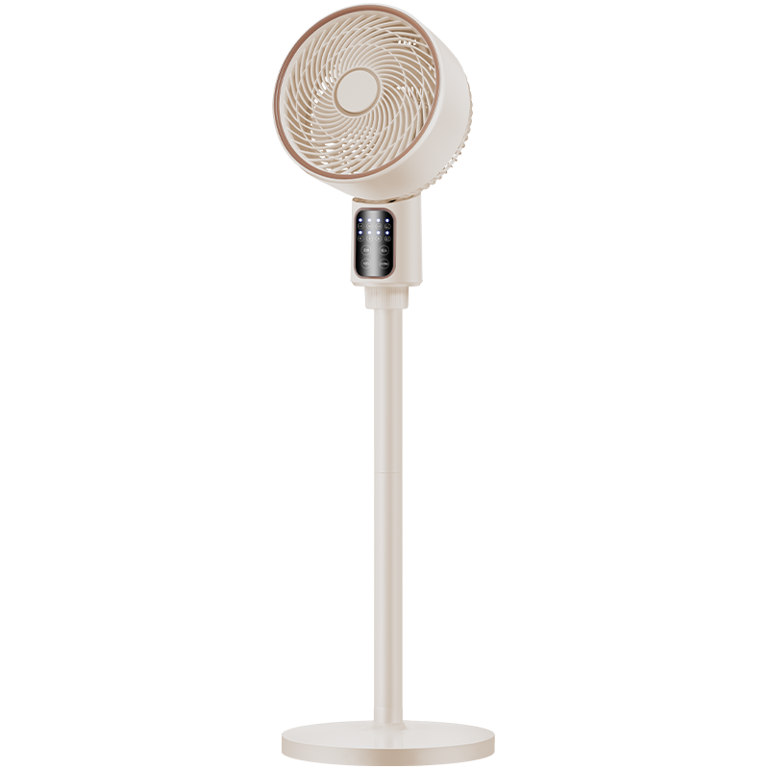
Specifications：Vertical Air Circulator Fan-FXL161D
Product Specifications |  | Customizable | Product Selling Points
Rated Voltage | 220V~50Hz | ✓ | 3 speed levels, remote control
Rated Power | 35W | ✓ | 3D Wide-angle Oscillation+7-hour timer
Body Material | Polypropylene (PP) | ✓ | Dual use as table or floor fan
Product Size | 300*260*1030mm |  | Powerful airflow, quiet operation
Carton Size | 305*259*395mm |  | Dense safety grill protection
Control Mode | Remote control operation | ✓ | Stable base with counterweight
Packing Qty. | 1 pcs/ctn | ✓ | Customizable colors
Blade Quantity | 3 Plastic Blades |  | OEM & ODM supported
Oscillation | Left & Right Oscillation |  | Carton color is customizable
Packing Data |  | Packing Quantity（pcs ）
Specifications | G.W /N.W(KG) | 20GP | 40GP | 40HQ
Vertical Air Circulator Fan | 4/3.1 | 830 | 1826 | 2258

Slide 48
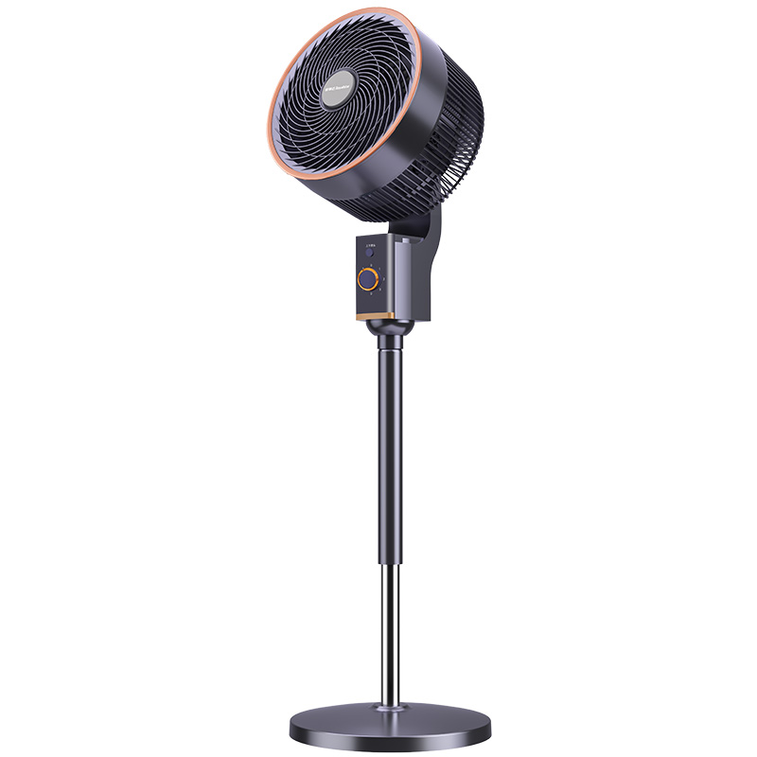
Specifications：Vertical Air Circulator Fan-FXL286
Product Specifications |  | Customizable | Product Selling Points
Rated Voltage | 220V~50Hz | ✓ | 3-speed rotary knob control
Rated Power | 45W | ✓ | 3D Wide-angle Oscillation
Body Material | Metal & Polypropylene (PP) | ✓ | Adjustable fan height
Product Size | 325*290*1095mm |  | Powerful airflow, quiet operation
Carton Size | 540*285*355mm |  | Dense safety grill protection
Control Mode | Rotary Knob Control | ✓ | Stable base with counterweight
Packing Qty. | 1 pcs/ctn | ✓ | Customizable colors
Blade Quantity | 3 Plastic Blades |  | OEM & ODM supported
Oscillation | Left & Right Oscillation |  | Carton color is customizable
Packing Data |  | Packing Quantity（pcs ）
Specifications | G.W /N.W(KG) | 20GP | 40GP | 40HQ
Vertical Air Circulator Fan | 5.8/4.8 | 458 | 1007 | 1245

Slide 49
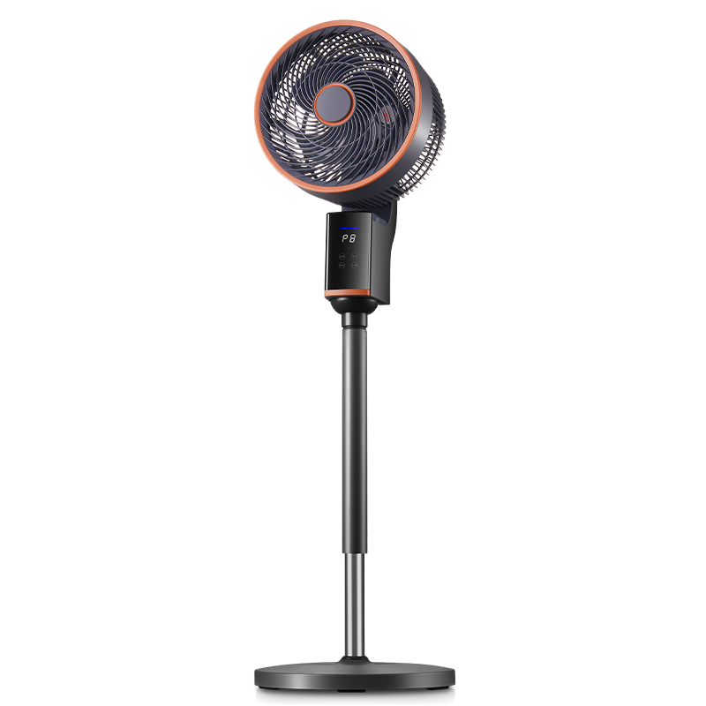
Specifications：Vertical Air Circulator Fan-FXL286D
Product Specifications |  | Customizable | Product Selling Points
Rated Voltage | 220V~50Hz | ✓ | 8 speed levels, remote control
Rated Power | 45W | ✓ | 3D Wide-angle Oscillation+24-hour timer
Body Material | Metal & Polypropylene (PP) | ✓ | Adjustable fan height
Product Size | 325*290*1095mm |  | Powerful airflow, quiet operation
Carton Size | 540*285*355mm |  | Dense safety grill protection
Control Mode | Remote control operation | ✓ | Stable base with counterweight
Packing Qty. | 1 pcs/ctn | ✓ | Customizable colors
Blade Quantity | 3 Plastic Blades |  | OEM & ODM supported
Oscillation | Left & Right Oscillation |  | Carton color is customizable
Packing Data |  | Packing Quantity（pcs ）
Specifications | G.W /N.W(KG) | 20GP | 40GP | 40HQ
Vertical Air Circulator Fan | 5.8/4.8 | 458 | 1007 | 1245

Slide 50
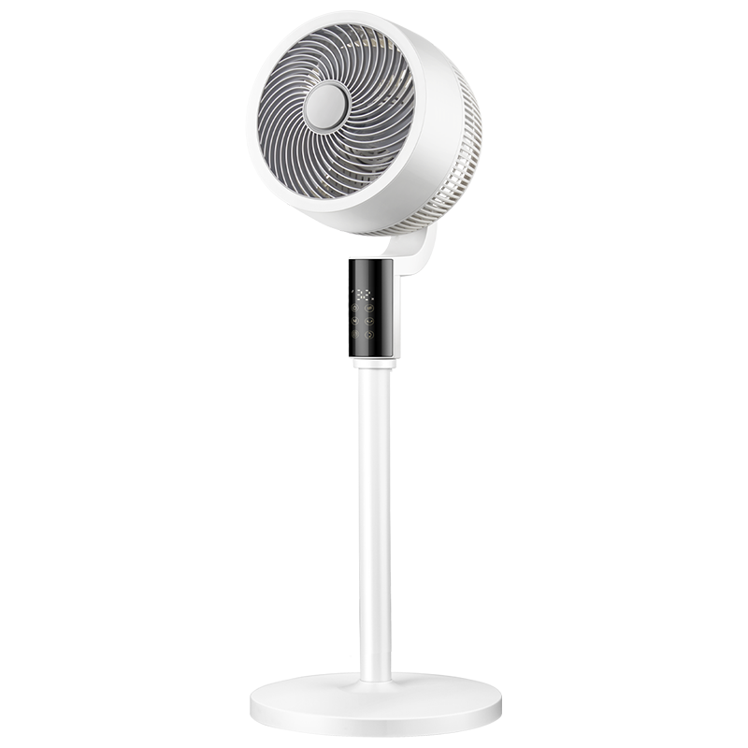
Specifications：Vertical Air Circulator Fan-FX580D
Product Specifications |  | Customizable | Product Selling Points
Rated Voltage | 220V~50Hz | ✓ | 6 speed levels, remote control
Rated Power | 40W | ✓ | 3D Wide-angle Oscillation+24-hour timer
Body Material | Polypropylene (PP)/（ABS） | ✓ | Dual use as table or floor fan
Product Size | 325*325*998mm |  | Powerful airflow, quiet operation
Carton Size | 565*330*360mm |  | Dense safety grill protection
Control Mode | Remote control operation | ✓ | Stable base with counterweight
Packing Qty. | 1 pcs/ctn | ✓ | Customizable colors
Blade Quantity | 3 Plastic Blades |  | OEM & ODM supported
Oscillation | Left & Right Oscillation |  | Carton color is customizable
Packing Data |  | Packing Quantity（pcs ）
Specifications | G.W /N.W(KG) | 20GP | 40GP | 40HQ
Vertical Air Circulator Fan | 5.8/4.4 | 372 | 819 | 1013

Slide 51
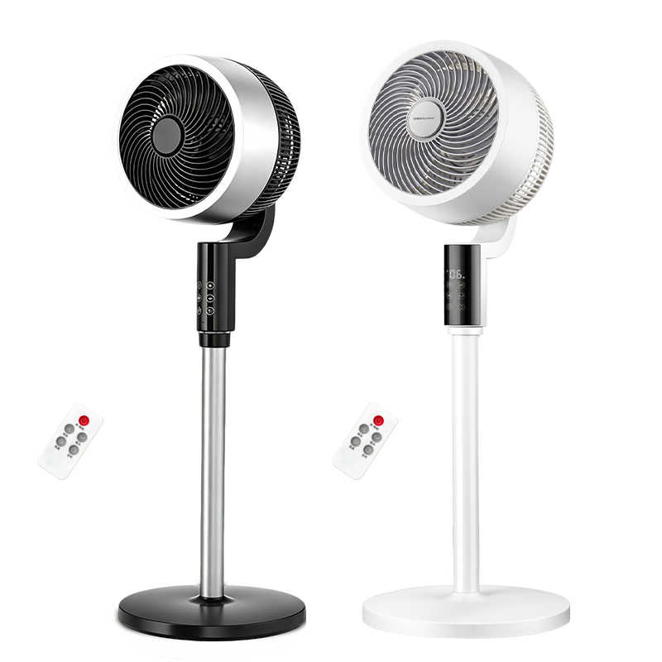
Specifications：DC Air Circulator Fan-FX580Z
Product Specifications |  | Customizable | Product Selling Points
Rated Voltage | 220V~50Hz | ✓ | 32 speed levels, remote control
Rated Power | 30W | ✓ | 3D Wide-angle Oscillation+24-hour timer
Body Material | Polypropylene (PP)/（ABS） | ✓ | Dual use as table or floor fan
Product Size | 325*325*998mm |  | Powerful airflow, quiet operation
Carton Size | 565*330*360mm |  | Dense safety grill protection
Control Mode | Remote control operation | ✓ | Stable base with counterweight
Packing Qty. | 1 pcs/ctn | ✓ | Customizable colors
Blade Quantity | 3 Plastic Blades |  | OEM & ODM supported
Oscillation | Left & Right Oscillation |  | Carton color is customizable
Packing Data |  | Packing Quantity（pcs ）
Specifications | G.W /N.W(KG) | 20GP | 40GP | 40HQ
DC Air Circulator Fan | 5.8/4.4 | 372 | 819 | 1013

Slide 52
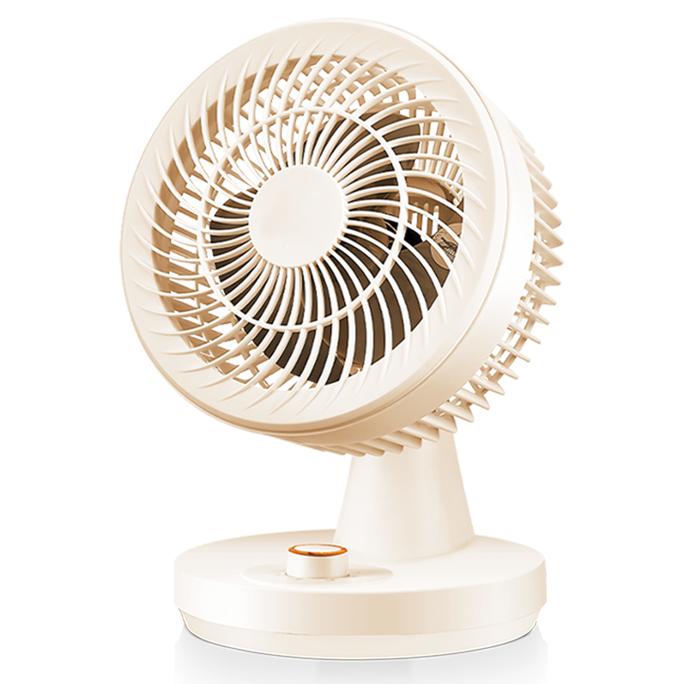
Specifications：Desktop Air Circulator-FXT160
Product Specifications |  | Customizable | Product Selling Points
Rated Voltage | 220V~50Hz | ✓ | 3-speed rotary knob control
Rated Power | 40W | ✓ | Left & right oscillation
Body Material | Polypropylene (PP) | ✓ | Ideal for desktop & office use
Product Size | 230*200*320mm |  | Powerful airflow, quiet operation
Carton Size | 240*210*335mm |  | Dense safety grill protection
Control Mode | Rotary Knob Control | ✓ | Better when used with air conditioner
Packing Qty. | 1 pcs/ctn | ✓ | Customizable colors
Blade Quantity | 3 Plastic Blades | ✓ | OEM & ODM supported
Oscillation | Left & Right Oscillation |  | Carton color is customizable
Packing Data |  | Packing Quantity（pcs ）
Specifications | G.W /N.W(KG) | 20GP | 40GP | 40HQ
Desktop Air Circulator | 1.8/1.4 | 1481 | 3258 | 4027

Slide 53
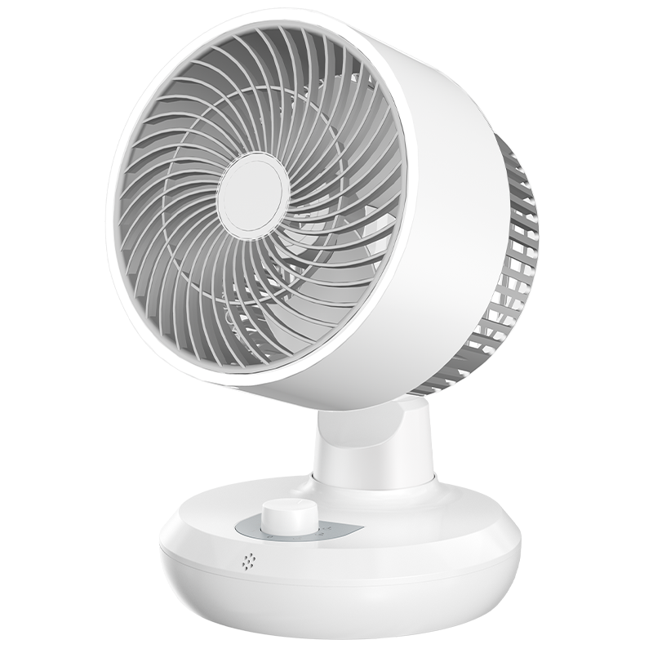
Specifications：Desktop Air Circulator-FX490
Product Specifications |  | Customizable | Product Selling Points
Rated Voltage | 220V~50Hz | ✓ | 3-speed rotary knob control
Rated Power | 40W | ✓ | Left & right oscillation
Body Material | Polypropylene (PP) | ✓ | Ideal for desktop & office use
Product Size | 210*210*300mm |  | Powerful airflow, quiet operation
Carton Size | 215*215*310mm |  | Dense safety grill protection
Control Mode | Rotary Knob Control | ✓ | Better when used with air conditioner
Packing Qty. | 1 pcs/ctn | ✓ | Customizable colors
Blade Quantity | 3 Plastic Blades |  | OEM & ODM supported
Oscillation | Left & Right Oscillation |  | Carton color is customizable
Packing Data |  | Packing Quantity（pcs ）
Specifications | G.W /N.W(KG) | 20GP | 40GP | 40HQ
Desktop Air Circulator | 1.8/1.4 | 1745 | 3838 | 4745

Slide 54
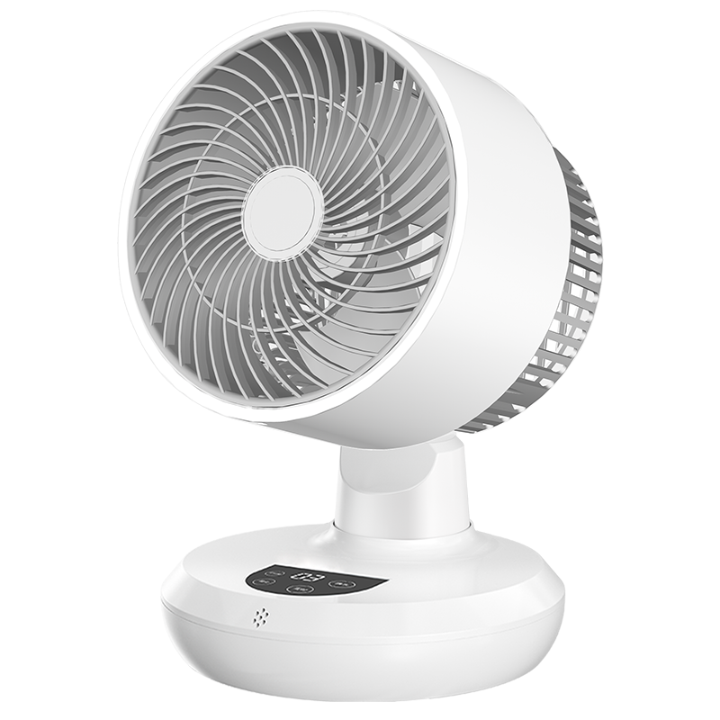
Specifications：Desktop Air Circulator-FX490D
Product Specifications |  | Customizable | Product Selling Points
Rated Voltage | 220V~50Hz | ✓ | 3 speed levels, remote control
Rated Power | 40W | ✓ | Left & right oscillation+9-hour timer
Body Material | Polypropylene (PP) | ✓ | Ideal for desktop & office use
Product Size | 210*210*300mm |  | Powerful airflow, quiet operation
Carton Size | 215*215*310mm |  | Dense safety grill protection
Control Mode | Remote control operation | ✓ | Better when used with air conditioner
Packing Qty. | 1 pcs/ctn | ✓ | Customizable colors
Blade Quantity | 3 Plastic Blades |  | OEM & ODM supported
Oscillation | Left & Right Oscillation |  | Carton color is customizable
Packing Data |  | Packing Quantity（pcs ）
Specifications | G.W /N.W(KG) | 20GP | 40GP | 40HQ
Desktop Air Circulator | 1.8/1.4 | 1745 | 3838 | 4745

Slide 55
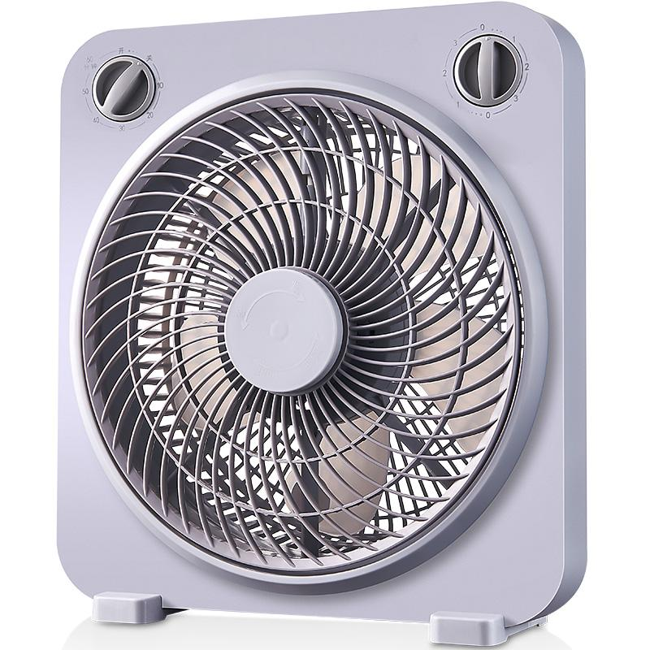
Specifications：Swing Blade Fan-KYT-256
Product Specifications |  | Customizable | Product Selling Points
Rated Voltage | 220V~50Hz | ✓ | 3-speed rotary knob control
Rated Power | 50W | ✓ | 60-minute timer
Body Material | Polypropylene (PP) | ✓ | Ideal for desktop & office use
Product Size | 320*130*350mm |  | Powerful airflow, quiet operation
Carton Size | 330*145*375mm |  | Dense safety grill protection
Control Mode | Rotary Knob Control | ✓ | Better when used with air conditioner
Packing Qty. | 1 pcs/ctn | ✓ | Customizable colors
Blade Quantity | 5 Plastic Blades |  | OEM & ODM supported
Oscillation |  |  | Carton color is customizable
Packing Data |  | Packing Quantity（pcs ）
Specifications | G.W /N.W(KG) | 20GP | 40GP | 40HQ
Swing Blade Fan | 1.8/1.4 | 1393 | 3065 | 3790

Slide 56
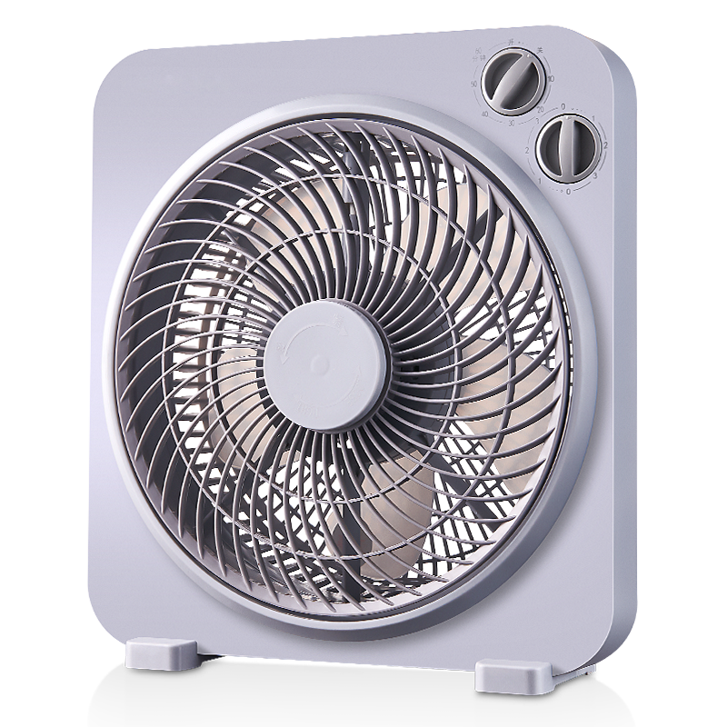
Specifications：Swing Blade Fan-KYT-25E
Product Specifications |  | Customizable | Product Selling Points
Rated Voltage | 220V~50Hz | ✓ | 3-speed rotary knob control
Rated Power | 50W | ✓ | 60-minute timer
Body Material | Polypropylene (PP) | ✓ | Ideal for desktop & office use
Product Size | 320*130*350mm |  | Powerful airflow, quiet operation
Carton Size | 330*145*375mm |  | Dense safety grill protection
Control Mode | Rotary Knob Control | ✓ | Better when used with air conditioner
Packing Qty. | 1 pcs/ctn | ✓ | Customizable colors
Blade Quantity | 5 Plastic Blades |  | OEM & ODM supported
Oscillation |  |  | Carton color is customizable
Packing Data |  | Packing Quantity（pcs ）
Specifications | G.W /N.W(KG) | 20GP | 40GP | 40HQ
Swing Blade Fan | 1.8/1.4 | 1393 | 3065 | 3790

Slide 57
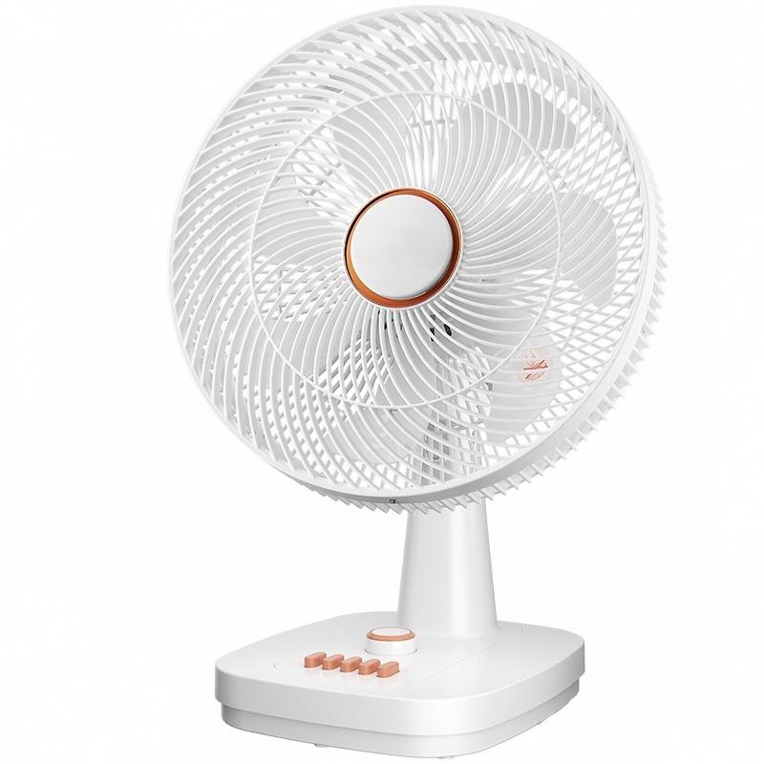
Specifications：Table Fan-FT-3001
Product Specifications |  | Customizable | Product Selling Points
Rated Voltage | 220V~50Hz | ✓ | 4-speed rotary knob control
Rated Power | 50W | ✓ | Left & right oscillation+60-minute timer
Body Material | Polypropylene (PP) | ✓ | Ideal for desktop & office use
Product Size | 360*300*560mm |  | Powerful airflow, quiet operation
Carton Size | 460*200*370mm |  | Dense safety grill protection
Control Mode | Rotary Knob Control | ✓ | Better when used with air conditioner
Packing Qty. | 1 pcs/ctn | ✓ | Customizable colors
Blade Quantity | 7Plastic Blades |  | OEM & ODM supported
Oscillation | Left & Right Oscillation |  | Carton color is customizable
Packing Data |  | Packing Quantity（pcs ）
Specifications | G.W /N.W(KG) | 20GP | 40GP | 40HQ
Table Fan | 3.1/2.5 | 734 | 1616 | 1998

Slide 58
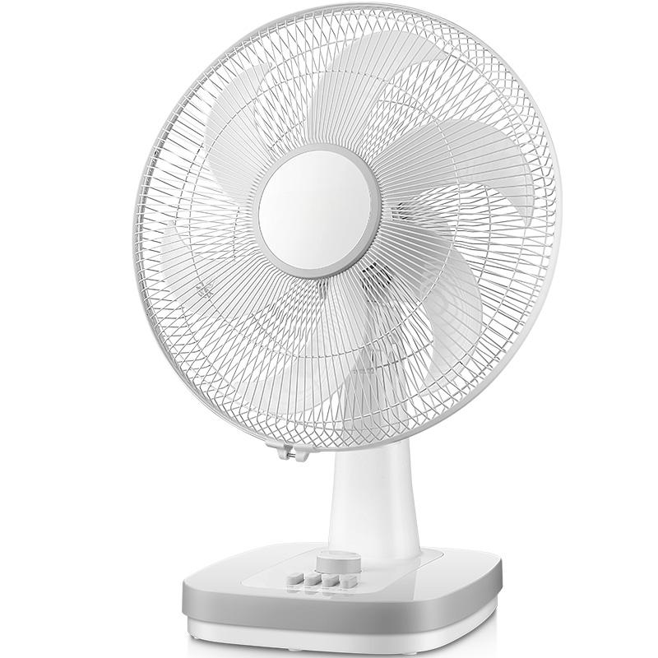
Specifications：Table Fan-FT-401
Product Specifications |  | Customizable | Product Selling Points
Rated Voltage | 220V~50Hz | ✓ | 4-speed rotary knob control
Rated Power | 60W | ✓ | Left & right oscillation+60-minute timer
Body Material | Metal & Polypropylene (PP) | ✓ | Ideal for desktop & office use
Product Size | 445*320*635mm |  | Powerful airflow, quiet operation
Carton Size | 480*200*460mm |  | Dense safety grill protection
Control Mode | Rotary Knob Control | ✓ | Better when used with air conditioner
Packing Qty. | 1 pcs/ctn | ✓ | Customizable colors
Blade Quantity | 6 Plastic Blades |  | OEM & ODM supported
Oscillation | Left & Right Oscillation |  | Carton color is customizable
Packing Data |  | Packing Quantity（pcs ）
Specifications | G.W /N.W(KG) | 20GP | 40GP | 40HQ
Table Fan | 3.8/3 | 566 | 1245 | 1540

Slide 59
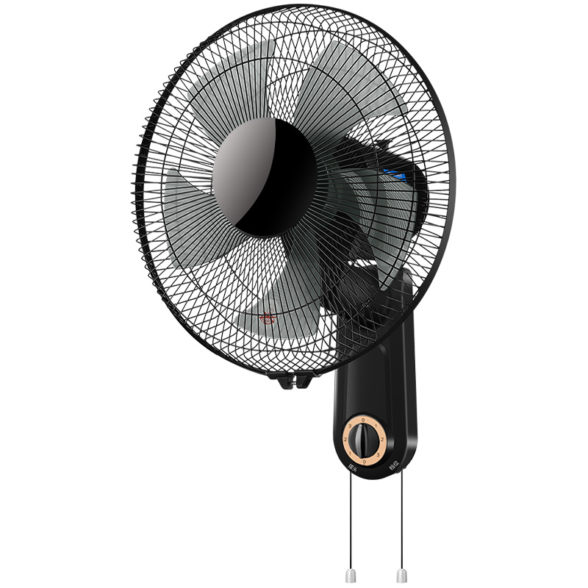
Specifications：Wall Fan-FB-3510
Product Specifications |  | Customizable | Product Selling Points
Rated Voltage | 220V~50Hz | ✓ | 3-speed rotary knob control
Rated Power | 50W | ✓ | Left & right oscillation
Body Material | Metal & Polypropylene (PP) | ✓ | wall-mounted, space-saving
Product Size | 410*260*550mm |  | Powerful airflow, quiet operation
Carton Size | 460*180*420mm |  | Dense safety grill protection
Control Mode | Rotary Knob Control | ✓ | Better when used with air conditioner
Packing Qty. | 1 pcs/ctn | ✓ | Customizable colors
Blade Quantity | 5 Plastic Blades |  | OEM & ODM supported
Oscillation | Left & Right Oscillation |  | Carton color is customizable
Packing Data |  | Packing Quantity（pcs ）
Specifications | G.W /N.W(KG) | 20GP | 40GP | 40HQ
Wall Fan | 3.1/2.5 | 719 | 1582 | 1955

Slide 60
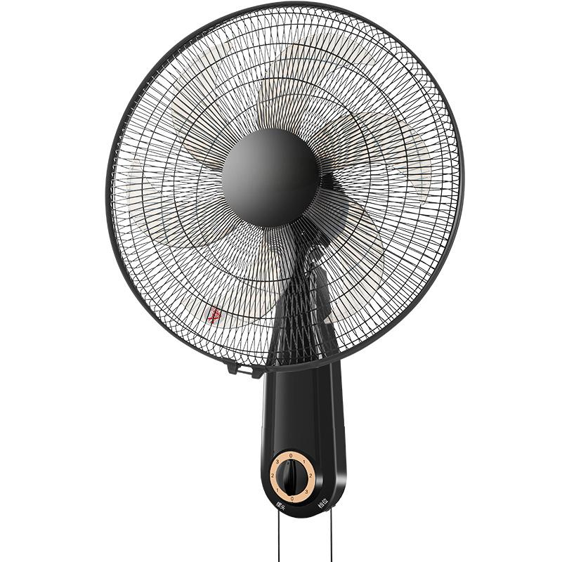
Specifications：Wall Fan-FB-4512
Product Specifications |  | Customizable | Product Selling Points
Rated Voltage | 220V~50Hz | ✓ | 3-speed rotary knob control
Rated Power | 60W | ✓ | Left & right oscillation
Body Material | Metal & Polypropylene (PP) | ✓ | wall-mounted, space-saving
Product Size | 500*330*590mm |  | Powerful airflow, quiet operation
Carton Size | 502*200*502mm |  | Dense safety grill protection
Control Mode | Rotary Knob Control | ✓ | Better when used with air conditioner
Packing Qty. | 1 pcs/ctn | ✓ | Customizable colors
Blade Quantity | 6 Plastic Blades | ✓ | OEM & ODM supported
Oscillation | Left & Right Oscillation |  | Carton color is customizable
Packing Data |  | Packing Quantity（pcs ）
Specifications | G.W /N.W(KG) | 20GP | 40GP | 40HQ
Wall Fan | 3.9/3 | 496 | 1091 | 1349

Slide 61
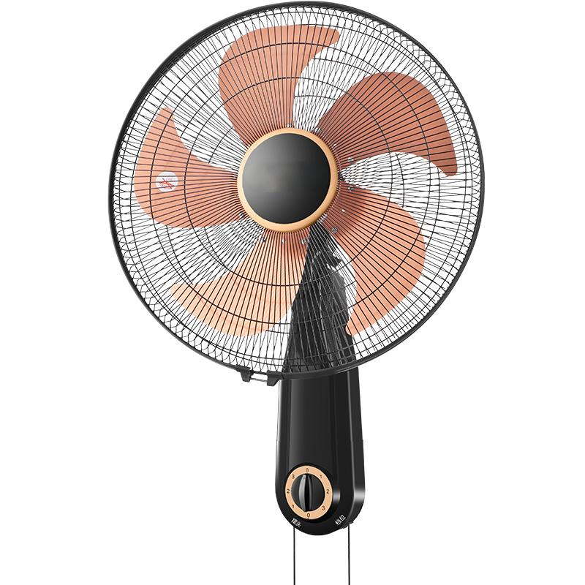
Specifications：Wall Fan-FB-4510
Product Specifications |  | Customizable | Product Selling Points
Rated Voltage | 220V~50Hz | ✓ | 3-speed rotary knob control
Rated Power | 60W | ✓ | Left & right oscillation
Body Material | Metal & Polypropylene (PP) | ✓ | wall-mounted, space-saving
Product Size | 500*330*590mm |  | Powerful airflow, quiet operation
Carton Size | 502*200*502mm |  | Dense safety grill protection
Control Mode | Rotary Knob Control | ✓ | Better when used with air conditioner
Packing Qty. | 1 pcs/ctn | ✓ | Customizable colors
Blade Quantity | 5 aluminum blades | ✓ | OEM & ODM supported
Oscillation | Left & Right Oscillation |  | Carton color is customizable
Packing Data |  | Packing Quantity（pcs ）
Specifications | G.W /N.W(KG) | 20GP | 40GP | 40HQ
Wall Fan | 3.9/3 | 496 | 1091 | 1349

Slide 62
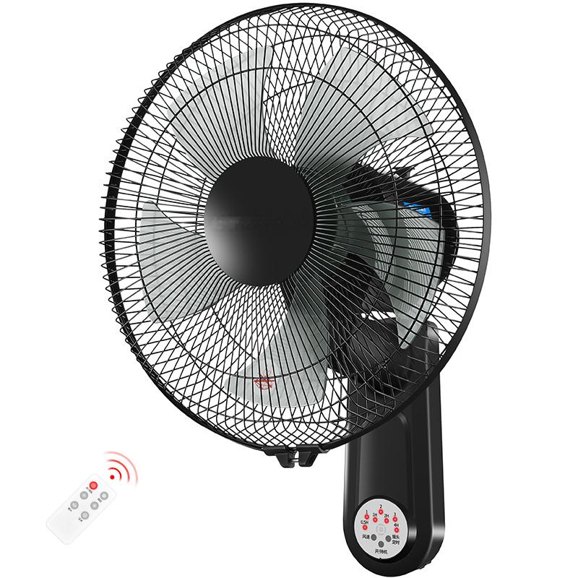
Specifications：Wall Fan-FB-3510D
Product Specifications |  | Customizable | Product Selling Points
Rated Voltage | 220V~50Hz | ✓ | 3 speed levels, remote control
Rated Power | 60W | ✓ | Left & right oscillation+7.5-hour timer
Body Material | Metal & Polypropylene (PP) | ✓ | wall-mounted, space-saving
Product Size | 410*260*550mm |  | Powerful airflow, quiet operation
Carton Size | 460*180*420mm |  | Dense safety grill protection
Control Mode | Remote control operation | ✓ | Better when used with air conditioner
Packing Qty. | 1 pcs/ctn | ✓ | Customizable colors
Blade Quantity | 5 Plastic Blades |  | OEM & ODM supported
Oscillation | Left & Right Oscillation |  | Carton color is customizable
Packing Data |  | Packing Quantity（pcs ）
Specifications | G.W /N.W(KG) | 20GP | 40GP | 40HQ
Wall Fan | 3.1/2.5 | 719 | 1582 | 1955

Slide 63
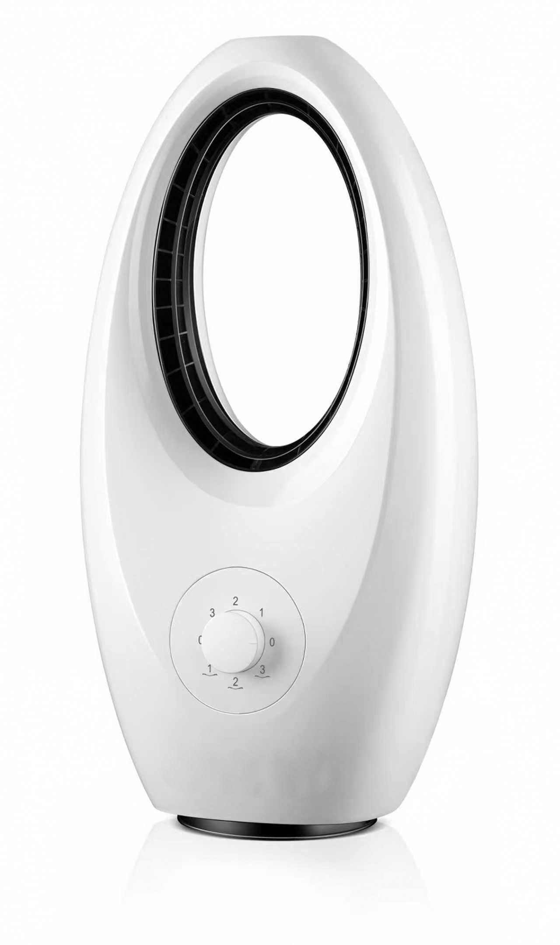
Specifications：Bladeless Fan-FT610
Product Specifications |  | Customizable | Product Selling Points
Rated Voltage | 220V~50Hz | ✓ | 3-speed rotary knob control
Rated Power | 60W | ✓ | Left & right oscillation
Body Material | Polypropylene (PP)/(ABS) | ✓ | Suitable for mothers and babies
Product Size | 292*180*565mm |  | Prevent finger pinching
Carton Size | 320*230*625mm |  | Compact & space-saving
Control Mode | Rotary Knob Control | ✓ | No disassembly for cleaning, easy wipe clean
Packing Qty. | 1 pcs/ctn | ✓ | Customizable colors
Blade Quantity |  |  | OEM & ODM supported
Oscillation | Left & Right Oscillation |  | Carton color is customizable
Packing Data |  | Packing Quantity（pcs ）
Specifications | G.W /N.W(KG) | 20GP | 40GP | 40HQ
Bladeless Fan | 3.5/2.5 | 543 | 1196 | 1478

Slide 64
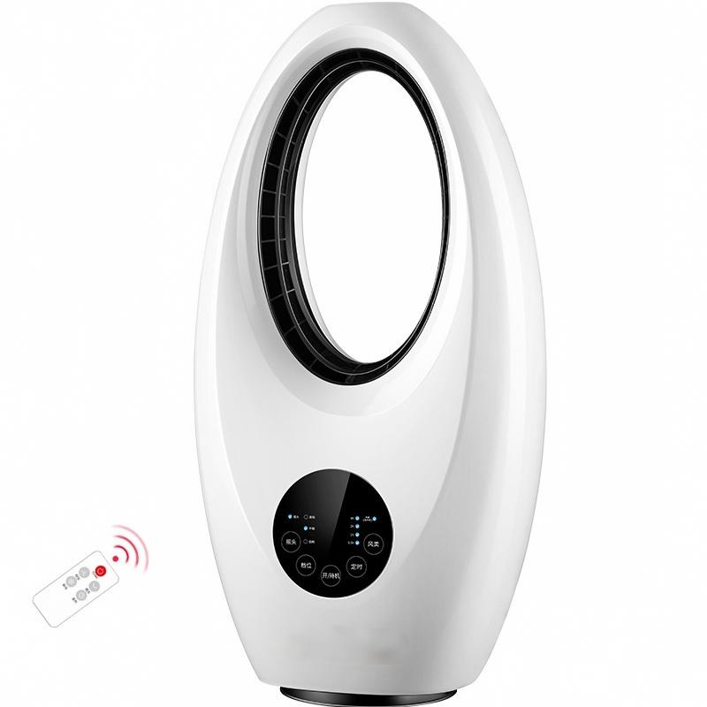
Specifications：Bladeless Fan-FT610D
Product Specifications |  | Customizable | Product Selling Points
Rated Voltage | 220V~50Hz | ✓ | 3 speed levels, remote control
Rated Power | 60W | ✓ | Left & right oscillation+7.5-hour timer
Body Material | Polypropylene (PP)/(ABS) | ✓ | Suitable for mothers and babies
Product Size | 292*180*565mm |  | Prevent finger pinching
Carton Size | 320*230*625mm |  | Compact & space-saving
Control Mode | Remote control operation | ✓ | No disassembly for cleaning, easy wipe clean
Packing Qty. | 1 pcs/ctn | ✓ | Customizable colors
Blade Quantity |  |  | OEM & ODM supported
Oscillation | Left & Right Oscillation |  | Carton color is customizable
Packing Data |  | Packing Quantity（pcs ）
Specifications | G.W /N.W(KG) | 20GP | 40GP | 40HQ
Bladeless Fan | 3.5/2.5 | 543 | 1196 | 1478

Slide 65
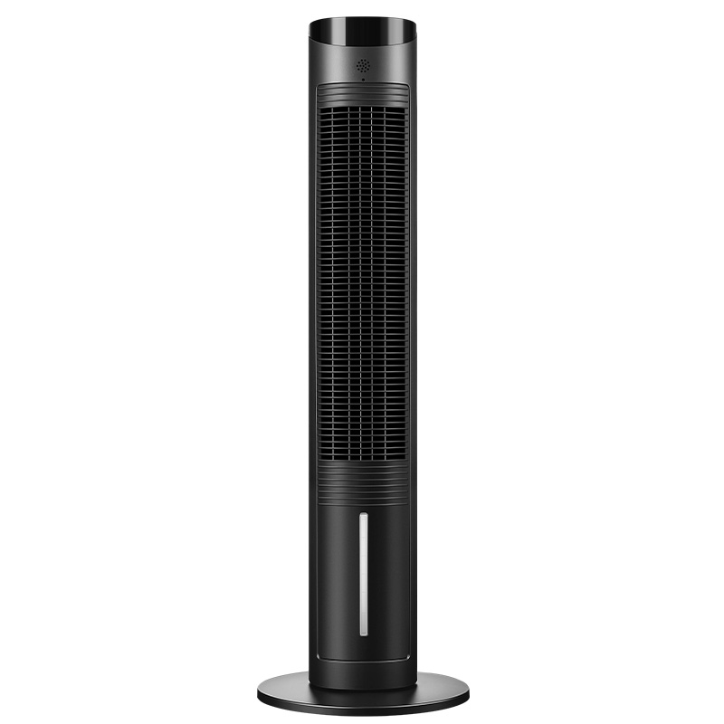
Specifications：DC Tower Air Cooler-FT-S5901D
Product Specifications |  | Customizable | Product Selling Points
Rated Voltage | 220V~50Hz | ✓ | 3 speed levels, remote control
Rated Power | 60W | ✓ | Left & right oscillation
Body Material | Polypropylene (PP) | ✓ | One-touch cool wind
Product Size | 280*280*1000mm |  | Supports water & ice addition
Carton Size | 540*210*490mm |  | Large 3.6L water tank
Control Mode | Remote control operation | ✓ | suitable for commercial, household & industrial use
Packing Qty. | 1 pcs/ctn | ✓ | Customizable colors
Blade Quantity |  |  | OEM & ODM supported
Oscillation | Left & Right Oscillation |  | Carton color is customizable
Packing Data |  | Packing Quantity（pcs ）
Specifications | G.W /N.W(KG) | 20GP | 40GP | 40HQ
Tower Air Cooler | 6.5/6 | 450 | 990 | 1224

Slide 66

Specifications：DC Tower Air Cooler-RS-26FL02J
Product Specifications |  | Customizable | Product Selling Points
Rated Voltage | 220V~50Hz | ✓ | 3-speed rotary knob control
Rated Power | 60W | ✓ | Left & right oscillation+24-hour timer
Body Material | Polypropylene (PP) | ✓ | One-touch cool wind
Product Size | 280*280*1000mm |  | Supports water & ice addition
Carton Size | 540*210*490mm |  | Large 3.6L water tank
Control Mode | Rotary Knob Control | ✓ | suitable for commercial, household & industrial use
Packing Qty. | 1 pcs/ctn | ✓ | Customizable colors
Blade Quantity |  |  | OEM & ODM supported
Oscillation | Left & Right Oscillation |  | Carton color is customizable
Packing Data |  | Packing Quantity（pcs ）
Specifications | G.W /N.W(KG) | 20GP | 40GP | 40HQ
Tower Air Cooler | 6.5/6 | 450 | 990 | 1224

Slide 67

Specifications：DC Tower Air Cooler-RS-26FL02J（blue）
Product Specifications |  | Customizable | Product Selling Points
Rated Voltage | 220V~50Hz | ✓ | Stepless Speed Control
Rated Power | 30W | ✓ | Left & right oscillation
Body Material | Polypropylene (PP) | ✓ | One-touch cool wind
Product Size | 280*280*1000mm |  | Supports water & ice addition
Carton Size | 540*210*490mm |  | Large 3.6L water tank
Control Mode | Rotary Knob Control | ✓ | Noise as low as 30dB
Packing Qty. | 1 pcs/ctn | ✓ | Customizable colors
Blade Quantity |  |  | OEM & ODM supported
Oscillation | Left & Right Oscillation |  | Carton color is customizable
Packing Data |  | Packing Quantity（pcs ）
Specifications | G.W /N.W(KG) | 20GP | 40GP | 40HQ
DC Tower Air Cooler | 6.5/6 | 450 | 990 | 1224

Slide 68

Specifications：DC Tower Air Cooler-RS-26FL02Y
Product Specifications |  | Customizable | Product Selling Points
Rated Voltage | 220V~50Hz | ✓ | 24 speed levels, remote control
Rated Power | 30W | ✓ | Left & right oscillation+24-hour timer
Body Material | Polypropylene (PP) | ✓ | One-touch cool wind
Product Size | 280*280*1000mm |  | Supports water & ice addition
Carton Size | 540*210*490mm |  | Large 3.6L water tank
Control Mode | Remote control operation | ✓ | Noise as low as 30dB
Packing Qty. | 1 pcs/ctn | ✓ | Customizable colors
Blade Quantity |  |  | OEM & ODM supported
Oscillation | Left & Right Oscillation |  | Carton color is customizable
Packing Data |  | Packing Quantity（pcs ）
Specifications | G.W /N.W(KG) | 20GP | 40GP | 40HQ
DC Tower Air Cooler | 6.5/6 | 450 | 990 | 1224

Slide 69

Specifications： Air Cooler-KTS-G1811/KTS-D1811
Product Specifications |  | Customizable | Product Selling Points
Rated Voltage | 220V~50Hz | ✓ | 3/4- speed levels
Rated Power | 100W | ✓ | Left & right oscillation
Body Material | Polypropylene (PP) | ✓ | Universal casters, easy to move
Product Size | 470*350*865mm |  | Supports water & ice addition
Carton Size | 490*365*880mm |  | Large 30L water tank
Control Mode | Rotary Knob Control/Remote control operation | ✓ | suitable for commercial, household & industrial use
Packing Qty. | 1 pcs/ctn | ✓ | Customizable colors
Water Tank Capacity | 30L |  | OEM & ODM supported
Other Functions | Remote control, 24-hour timer |  | Carton color is customizable
Packing Data |  | Packing Quantity（pcs ）
Specifications | G.W /N.W(KG) | 20GP | 40GP | 40HQ
Air Cooler | 9.4/7.5 | 159 | 349 | 432

Slide 70
Specifications： Air Cooler-KTS-G1802/KTS-G1805
Product Specifications |  | Customizable | Product Selling Points
Rated Voltage | 220V~50Hz | ✓ | 3/4- speed levels
Rated Power | 100W | ✓ | Left & right oscillation
Body Material | Polypropylene (PP) | ✓ | Universal casters, easy to move
Product Size | 470*350*990mm |  | Supports water & ice addition
Carton Size | 490*365*980mm |  | Large 30L water tank
Control Mode | Rotary Knob Control/Remote control operation | ✓ | suitable for commercial, household & industrial use
Packing Qty. | 1 pcs/ctn | ✓ | Customizable colors
Water Tank Capacity | 30L |  | OEM & ODM supported
Other Functions | Remote control, 24-hour timer |  | Carton color is customizable
Packing Data |  | Packing Quantity（pcs ）
Specifications | G.W /N.W(KG) | 20GP | 40GP | 40HQ
Air Cooler | 10.6/8.6 | 120 | 263 | 325

Slide 71
Specifications： Air Cooler-KTS-G1800A/KTS-G1809
Product Specifications |  | Customizable | Product Selling Points
Rated Voltage | 220V~50Hz | ✓ | 3/4- speed levels
Rated Power | 100W | ✓ | Left & right oscillation
Body Material | Polypropylene (PP) | ✓ | Universal casters, easy to move
Product Size | 470*350*1090mm |  | Supports water & ice addition
Carton Size | 520*410*1080mm |  | Large 45L water tank
Control Mode | Rotary Knob Control/Remote control operation | ✓ | suitable for commercial, household & industrial use
Packing Qty. | 1 pcs/ctn | ✓ | Customizable colors
Water Tank Capacity | 45L |  | OEM & ODM supported
Other Functions | Remote control, 24-hour timer |  | Carton color is customizable
Packing Data |  | Packing Quantity（pcs ）
Specifications | G.W /N.W(KG) | 20GP | 40GP | 40HQ
Air Cooler | 11.6/9.5 | 109 | 239 | 295

Slide 72

Specifications： Air Cooler-KTS-G1803
Product Specifications |  | Customizable | Product Selling Points
Rated Voltage | 220V~50Hz | ✓ | 3- speed levels
Rated Power | 220W | ✓ | Left & right oscillation
Body Material | Polypropylene (PP) | ✓ | Universal casters, easy to move
Product Size | 580*400*1260mm |  | Supports water & ice addition
Carton Size | 635*440*1250mm |  | Large 50L water tank
Control Mode | Rotary Knob Control/Remote control operation | ✓ | suitable for commercial, household & industrial use
Packing Qty. | 1 pcs/ctn | ✓ | Customizable colors
Water Tank Capacity | 50L |  | OEM & ODM supported
Other Functions | Remote control, 24-hour timer |  | Carton color is customizable
Packing Data |  | Packing Quantity（pcs ）
Specifications | G.W /N.W(KG) | 20GP | 40GP | 40HQ
Air Cooler | 16.9/13.8 | 72 | 157 | 195

Slide 73

Specifications： Air Cooler-RS-26FL01J
Product Specifications |  | Customizable | Product Selling Points
Rated Voltage | 220V~50Hz | ✓ | 4- speed levels
Rated Power | 100W | ✓ | Left & right oscillation
Body Material | Polypropylene (PP) | ✓ | Universal casters, easy to move
Product Size | 470*350*865mm |  | Supports water & ice addition
Carton Size | 490*365*880mm |  | Large 30L water tank
Control Mode | Button control | ✓ | suitable for commercial, household & industrial use
Packing Qty. | 1 pcs/ctn | ✓ | Customizable colors
Water Tank Capacity | 30L |  | OEM & ODM supported
Other Functions |  |  | Carton color is customizable
Packing Data |  | Packing Quantity（pcs ）
Specifications | G.W /N.W(KG) | 20GP | 40GP | 40HQ
Air Cooler | 9.4/7.5 | 159 | 349 | 432

Slide 74
Specifications： Air Cooler-KTS-G1800
Product Specifications |  | Customizable | Product Selling Points
Rated Voltage | 220V~50Hz | ✓ | 4- speed levels
Rated Power | 100W | ✓ | Left & right oscillation
Body Material | Polypropylene (PP) | ✓ | Universal casters, easy to move
Product Size | 470*350*990mm |  | Supports water & ice addition
Carton Size | 490*365*980mm |  | Large 30L water tank
Control Mode | Button control | ✓ | suitable for commercial, household & industrial use
Packing Qty. | 1 pcs/ctn | ✓ | Customizable colors
Water Tank Capacity | 30L |  | OEM & ODM supported
Other Functions |  |  | Carton color is customizable
Packing Data |  | Packing Quantity（pcs ）
Specifications | G.W /N.W(KG) | 20GP | 40GP | 40HQ
Air Cooler | 10.6/8.6 | 120 | 263 | 325

Slide 75
Specifications： Air Cooler-KTS-G1806
Product Specifications |  | Customizable | Product Selling Points
Rated Voltage | 220V~50Hz | ✓ | 4- speed levels
Rated Power | 100W | ✓ | Left & right oscillation
Body Material | Polypropylene (PP) | ✓ | Universal casters, easy to move
Product Size | 470*350*1090mm |  | Supports water & ice addition
Carton Size | 520*410*1080mm |  | Large 45L water tank
Control Mode | Button control | ✓ | suitable for commercial, household & industrial use
Packing Qty. | 1 pcs/ctn | ✓ | Customizable colors
Water Tank Capacity | 45L |  | OEM & ODM supported
Other Functions |  |  | Carton color is customizable
Packing Data |  | Packing Quantity（pcs ）
Specifications | G.W /N.W(KG) | 20GP | 40GP | 40HQ
Air Cooler | 11.6/9.5 | 109 | 239 | 295

Slide 76

Specifications：NTS-208A（Customizable）
Product Specifications |  | Customizable | Product Selling Points
Rated Voltage | 220V~50Hz | ✓ | 3-speed rotary knob control
Rated Power | 2000W | ✓ | Vertical & Horizontal Dual Use
Heating Element | Nichrome Alloy Heating Wire |  | Overheat Protection
Product Size | 245*140*245 mm |  | quiet operation
Carton Size | 270*150*270 mm |  | Dense safety grill protection
Control Mode | Rotary Knob Control | ✓ | Rapid Heat-up
Packing Qty. | 1 pcs/ctn | ✓ | Customizable colors
FR Material | Support |  | OEM & ODM supported
Body Material | Metal & Polypropylene (PP) | ✓ | Carton color is customizable
Packing Data |  | Packing Quantity（pcs ）
Specifications | G.W /N.W(KG) | 20GP | 40GP | 40HQ
NTS-208A | 1.3/1.0 | 2286 | 5030 | 6219

Slide 77

Specifications：NTS-208A3（Customizable）
Product Specifications |  | Customizable | Product Selling Points
Rated Voltage | 220V~50Hz | ✓ | 3-speed rotary knob control
Rated Power | 2000W | ✓ | Vertical & Horizontal Dual Use
Heating Element | Nichrome Alloy Heating Wire |  | Overheat Protection
Product Size | 245*140*245 mm |  | quiet operation
Carton Size | 270*150*270 mm |  | Dense safety grill protection
Control Mode | Rotary Knob Control | ✓ | Rapid Heat-up
Packing Qty. | 1 pcs/ctn | ✓ | Customizable colors
FR Material | Support |  | OEM & ODM supported
Body Material | Metal & Polypropylene (PP) | ✓ | Carton color is customizable
Packing Data |  | Packing Quantity（pcs ）
Specifications | G.W /N.W(KG) | 20GP | 40GP | 40HQ
NTS-208A3 | 1.3/1.0 | 2286 | 5030 | 6219

Slide 78

Specifications：NTS-208B（Customizable）
Product Specifications |  | Customizable | Product Selling Points
Rated Voltage | 220V~50Hz | ✓ | 3-speed rotary knob control
Rated Power | 2000W | ✓ | Vertical & Horizontal Dual Use
Heating Element | Nichrome Alloy Heating Wire |  | Overheat Protection
Product Size | 225*120*245 mm |  | quiet operation
Carton Size | 260*135*270 mm |  | Dense safety grill protection
Control Mode | Rotary Knob Control | ✓ | Rapid Heat-up
Packing Qty. | 1 pcs/ctn | ✓ | Customizable colors
FR Material | Support |  | OEM & ODM supported
Body Material | Metal & Polypropylene (PP) | ✓ | Carton color is customizable
Packing Data |  | Packing Quantity（pcs ）
Specifications | G.W /N.W(KG) | 20GP | 40GP | 40HQ
NTS-208A | 1.4/1.0 | 2638 | 5804 | 7175

Slide 79

Specifications：NTC-1805（Customizable）
Product Specifications |  | Customizable | Product Selling Points
Rated Voltage | 220V~50Hz | ✓ | 3-speed rotary knob control
Rated Power | 1800W | ✓ | Tip-over Protection
Heating Element | PTC Ceramic (Graphene) |  | Overheat Protection
Product Size | 150*140*252 mm |  | quiet operation
Carton Size | 190*180*305 mm |  | Wide-Angle Oscillation
Control Mode | Rotary Knob Control | ✓ | Rapid Heat-up
Packing Qty. | 1 pcs/ctn | ✓ | Customizable colors
FR Material | Support |  | OEM & ODM supported
Body Material | Metal & Polypropylene (PP) | ✓ | Carton color is customizable
Packing Data |  | Packing Quantity（pcs ）
Specifications | G.W /N.W(KG) | 20GP | 40GP | 40HQ
NTC-1805 | 1.7/1.2 | 2397 | 5273 | 6519

Slide 80

Specifications：NTC-1805D（Customizable）
Product Specifications |  | Customizable | Product Selling Points
Rated Voltage | 220V~50Hz | ✓ | 3-speed adjustable/7.5-Hour Timer
Rated Power | 1800W | ✓ | Tip-over Protection
Heating Element | PTC Ceramic (Graphene) |  | Overheat Protection
Product Size | 150*140*252 mm |  | quiet operation
Carton Size | 190*180*305 mm |  | Wide-Angle Oscillation
Control Mode | Rotary Knob Control | ✓ | Rapid Heat-up
Packing Qty. | 1 pcs/ctn | ✓ | Customizable colors
FR Material | Support |  | OEM & ODM supported
Body Material | Metal & Polypropylene (PP) | ✓ | Carton color is customizable
Packing Data |  | Packing Quantity（pcs ）
Specifications | G.W /N.W(KG) | 20GP | 40GP | 40HQ
NTC-1805D | 1.7/1.2 | 2397 | 5273 | 6519

Slide 81

Specifications：NTC-185（Customizable）
Product Specifications |  | Customizable | Product Selling Points
Rated Voltage | 220V~50Hz | ✓ | 3-speed rotary knob control
Rated Power | 2000W | ✓ | Tip-over Protection
Heating Element | PTC Ceramic (Graphene) |  | Overheat Protection
Product Size | 205*247*328 mm |  | quiet operation
Carton Size | 260*235*360 mm |  | Wide-Angle Oscillation
Control Mode | Rotary Knob Control | ✓ | Rapid Heat-up
Packing Qty. | 1 pcs/ctn | ✓ | Customizable colors
FR Material | Support |  | OEM & ODM supported
Body Material | Metal & Polypropylene (PP) | ✓ | Carton color is customizable
Packing Data |  | Packing Quantity（pcs ）
Specifications | G.W /N.W(KG) | 20GP | 40GP | 40HQ
NTC-185 | 2.5/1.8 | 1137 | 2500 | 3091

Slide 82

Specifications：NTC-1805D（Customizable）
Product Specifications |  | Customizable | Product Selling Points
Rated Voltage | 220V~50Hz | ✓ | 3-speed adjustable/7.5-Hour Timer
Rated Power | 2000W | ✓ | Tip-over Protection
Heating Element | PTC Ceramic (Graphene) |  | Overheat Protection
Product Size | 205*247*328 mm |  | quiet operation
Carton Size | 260*235*360 mm |  | Wide-Angle Oscillation
Control Mode | Remote & Touch-screen Control | ✓ | Rapid Heat-up
Packing Qty. | 1 pcs/ctn | ✓ | Customizable colors
FR Material | Support |  | OEM & ODM supported
Body Material | Metal & Polypropylene (PP) | ✓ | Carton color is customizable
Packing Data |  | Packing Quantity（pcs ）
Specifications | G.W /N.W(KG) | 20GP | 40GP | 40HQ
NTC-185D | 2.5/1.8 | 1005 | 2211 | 2733

Slide 83

Specifications：NTC-2058（Customizable）
Product Specifications |  | Customizable | Product Selling Points
Rated Voltage | 220V~50Hz | ✓ | 3-speed adjustable
Rated Power | 2000W | ✓ | Tip-over Protection
Heating Element | PTC Ceramic (Graphene) |  | Overheat Protection
Product Size | 230*230*605 mm |  | quiet operation
Carton Size | 170*130*635 mm |  | Wide-Angle Oscillation
Control Mode | Rotary Knob Control | ✓ | Rapid Heat-up
Packing Qty. | 1 pcs/ctn | ✓ | Customizable colors
FR Material | Support |  | OEM & ODM supported
Body Material | Metal & Polypropylene (PP) | ✓ | Carton color is customizable
Packing Data |  | Packing Quantity（pcs ）
Specifications | G.W /N.W(KG) | 20GP | 40GP | 40HQ
NTC-2058 | 2.3/1.7 | 1781 | 3919 | 4846

Slide 84

Specifications：NTC-2058D（Customizable）
Product Specifications |  | Customizable | Product Selling Points
Rated Voltage | 220V~50Hz | ✓ | 3-speed adjustable/15-Hour Timer
Rated Power | 2000W | ✓ | Tip-over Protection
Heating Element | PTC Ceramic (Graphene) |  | Overheat Protection
Product Size | 230*230*605 mm |  | quiet operation
Carton Size | 170*130*635 mm |  | Wide-Angle Oscillation
Control Mode | Remote & Touch-screen Control | ✓ | Rapid Heat-up
Packing Qty. | 1 pcs/ctn | ✓ | Customizable colors
FR Material | Support |  | OEM & ODM supported
Body Material | Metal & Polypropylene (PP) | ✓ | Carton color is customizable
Packing Data |  | Packing Quantity（pcs ）
Specifications | G.W /N.W(KG) | 20GP | 40GP | 40HQ
NTC-2058D | 2.2/1.8 | 1781 | 3919 | 4846

Slide 85

Specifications： FGW-828S（Customizable）
Product Specifications |  | Customizable | Product Selling Points
Rated Voltage | 220V~50Hz | ✓ | 2-speed adjustable / Table‑floor Dual-use
Rated Power | 900W | ✓ | Tip-over Protection
Heating Element | Carbon-Fiber Tube |  | Overheat Protection
Product Size | 370*370*1000 mm | ✓ | Quiet operation
Carton Size | 370*330*370 mm | ✓ | Wide-Angle Oscillation
Control Mode | Rotary Knob Control | ✓ | Rapid Heat-up
Packing Qty. | 1 pcs/ctn | ✓ | Customizable colors
FR Material | Support |  | OEM & ODM supported
Body Material | Metal & Polypropylene (PP) | ✓ | Carton color is customizable
Packing Data |  | Packing Quantity（pcs ）
Specifications | G.W /N.W(KG) | 20GP | 40GP | 40HQ
FGW-828S | 3.8/3.0 | 553 | 1217 | 1505

Slide 86
Specifications： FGW-828D（Customizable）
Product Specifications |  | Customizable | Product Selling Points
Rated Voltage | 220V~50Hz | ✓ | 2-speed adjustable / 15-Hour Timer
Rated Power | 900W | ✓ | Tip-over Protection
Heating Element | Carbon-Fiber Tube |  | Overheat Protection
Product Size | 370*370*1000 mm |  | Quiet operation
Carton Size | 370*330*370 mm |  | Wide-Angle Oscillation
Control Mode | Remote & Touch-screen Control | ✓ | Rapid Heat-up
Packing Qty. | 1 pcs/ctn | ✓ | Customizable colors
FR Material | Support |  | OEM & ODM supported
Body Material | Metal & Polypropylene (PP) | ✓ | Carton color is customizable
Packing Data |  | Packing Quantity（pcs ）
Specifications | G.W /N.W(KG) | 20GP | 40GP | 40HQ
FGW-828D | 3.8/3.0 | 553 | 1217 | 1505

Slide 87

Specifications： FGW-620S（Customizable）
Product Specifications |  | Customizable | Product Selling Points
Rated Voltage | 220V~50Hz | ✓ | 2-speed adjustable
Rated Power | 600W | ✓ | Tip-over Protection
Heating Element | Quartz Tube |  | Overheat Protection
Product Size | 310*215*390 mm |  | Quiet operation
Carton Size | 250*230*405 mm |  | Reinforced Base
Control Mode | Rotary Knob Control | ✓ | Rapid Heat-up
Packing Qty. | 1 pcs/ctn | ✓ | Customizable colors
FR Material | Support |  | OEM & ODM supported
Body Material | Metal & Polypropylene (PP) | ✓ | Carton color is customizable
Packing Data |  | Packing Quantity（pcs ）
Specifications | G.W /N.W(KG) | 20GP | 40GP | 40HQ
FGW-620S | 1.5/0.9 | 962 | 2116 | 2616

Slide 88

Specifications： FGW-820S2（Customizable）
Product Specifications |  | Customizable | Product Selling Points
Rated Voltage | 220V~50Hz | ✓ | 2-speed adjustable/2-Hour Timer
Rated Power | 900W | ✓ | Tip-over Protection
Heating Element | Quartz Tube |  | Overheat Protection
Product Size | 370*270*450 mm |  | Quiet operation
Carton Size | 280*280*475 mm |  | Wide-Angle Oscillation
Control Mode | Rotary Knob Control | ✓ | Rapid Heat-up
Packing Qty. | 1 pcs/ctn | ✓ | Customizable colors
FR Material | Support |  | OEM & ODM supported
Body Material | Metal & Polypropylene (PP) | ✓ | Carton color is customizable
Packing Data |  | Packing Quantity（pcs ）
Specifications | G.W /N.W(KG) | 20GP | 40GP | 40HQ
FGW-820S2 | 1.75/1.1 | 671 | 1477 | 1826

Slide 89

Specifications： FGW-820S（Customizable）
Product Specifications |  | Customizable | Product Selling Points
Rated Voltage | 220V~50Hz | ✓ | 2-speed adjustable
Rated Power | 900W | ✓ | Tip-over Protection
Heating Element | Carbon‑fiber Heating Tube |  | Overheat Protection
Product Size | 410*310*500 mm |  | Quiet operation
Carton Size | 310*310*485 mm |  | Wide-Angle Oscillation
Control Mode | Rotary Knob Control | ✓ | Rapid Heat-up
Packing Qty. | 1 pcs/ctn | ✓ | Customizable colors
FR Material | Support |  | OEM & ODM supported
Body Material | Metal & Polypropylene (PP) | ✓ | Carton color is customizable
Packing Data |  | Packing Quantity（pcs ）
Specifications | G.W /N.W(KG) | 20GP | 40GP | 40HQ
FGW-820S | 2.2/1.4 | 536 | 1180 | 1459

Slide 90

Specifications： FGW-819（Customizable）
Product Specifications |  | Customizable | Product Selling Points
Rated Voltage | 220V~50Hz | ✓ | 2-speed adjustable
Rated Power | 800W | ✓ | Tip-over Protection
Heating Element | Quartz Tube |  | Overheat Protection
Product Size | 295*145*390 mm |  | Quiet operation
Carton Size | 310*160*405 mm |  | Dense‑mesh Safety Guard
Control Mode | Rotary Knob Control | ✓ | Rapid Heat-up
Packing Qty. | 1 pcs/ctn | ✓ | Customizable colors
FR Material | Button Control |  | OEM & ODM supported
Body Material | Metal & Polypropylene (PP) | ✓ | Carton color is customizable
Packing Data |  | Packing Quantity（pcs ）
Specifications | G.W /N.W(KG) | 20GP | 40GP | 40HQ
FGW-820S | 1.4/0.9 | 1326 | 2918 | 3608

Slide 91

Specifications： Convector Heater（Customizable）-NDL-2001Y
Product Specifications |  | Customizable | Product Selling Points
Rated Voltage | 220V~50Hz | ✓ | 2‑level remote adjustment
Rated Power | 2000W | ✓ | 24‑hour timer
Heating Element | Aluminum Heating Element | ✓ | Zero‑light operation, low noise working
Product Size | 1020*70*405mm |  | Enlarged air outlet for faster heat convection
Carton Size | 1145*125*530mm |  | Built‑in side handles for easy movement
Control Mode | Remote control operation | ✓ | Overheat protection & tip‑over auto shut‑off
Packing Qty. | 1 pcs/ctn | ✓ | Customizable colors
FR Material | Support |  | OEM & ODM supported
Body Material | Metal & Polypropylene (PP) | ✓ | Carton color is customizable
Packing Data |  | Packing Quantity（pcs ）
Specifications | G.W /N.W(KG) | 20GP | 40GP | 40HQ
Baseboard Heater | 9.2/7.3 | 331 | 728 | 900

Slide 92

Specifications： Convector Heater（Customizable）-NH20M305
Product Specifications |  | Customizable | Product Selling Points
Rated Voltage | 220V~50Hz | ✓ | 2 speeds,Button adjustment
Rated Power | 2000W | ✓ | Efficient heat‑conducting Ni‑Cr heating wire
Heating Element | Graphene Aluminum Heating Element | ✓ | Zero‑light operation, low noise working+Clothes rack
Product Size | 700*90*450mm |  | Enlarged air outlet for faster heat convection
Carton Size | 750*150*520mm |  | Built‑in side handles for easy movement
Control Mode | Button adjustment | ✓ | Overheat protection & tip‑over auto shut‑off
Packing Qty. | 1 pcs/ctn | ✓ | Customizable colors
FR Material | Support |  | OEM & ODM supported
Body Material | Metal & Polypropylene (PP) | ✓ | Carton color is customizable
Packing Data |  | Packing Quantity（pcs ）
Specifications | G.W /N.W(KG) | 20GP | 40GP | 40HQ
Baseboard Heater | 4.9/3.7 | 427 | 940 | 1162

Slide 93

Specifications： Convector Heater（Customizable）-NDL-2008
Product Specifications |  | Customizable | Product Selling Points
Rated Voltage | 220V~50Hz | ✓ | 2 speeds, Button adjustment
Rated Power | 2000W | ✓ | Efficient heat‑conducting Ni‑Cr heating wire
Heating Element | Graphene Aluminum Heating Element | ✓ | Zero‑light operation, low noise working
Product Size | 645*200*330mm |  | Enlarged air outlet for faster heat convection
Carton Size | 690*165*360mm |  | Built‑in side handles for easy movement
Control Mode | Button adjustment | ✓
Packing Qty. | 1 pcs/ctn | ✓ | Customizable colors
FR Material | Support |  | OEM & ODM supported
Body Material | Metal & Polypropylene (PP) | ✓ | Carton color is customizable
Packing Data |  | Packing Quantity（pcs ）
Specifications | G.W /N.W(KG) | 20GP | 40GP | 40HQ
Baseboard Heater | 3.7/2.6 | 610 | 1342 | 1659

Slide 94

Specifications： Baseboard Heater（Customizable）-NDT-2007
Product Specifications |  | Customizable | Product Selling Points
Rated Voltage | 220V~50Hz | ✓ | 2 speeds, Mechanical knob control
Rated Power | 2000W | ✓ | Efficient heat‑conducting Ni‑Cr heating wire
Heating Element | Graphene Aluminum Heating Element | ✓ | Zero‑light operation, low noise working
Product Size | 875*134*263mm |  | Enlarged air outlet for faster heat convection
Carton Size | 980*130*250mm |  | Built‑in side handles for easy movement
Control Mode | Mechanical knob control | ✓ | Overheat protection & tip‑over auto shut‑off
Packing Qty. | 1 pcs/ctn | ✓ | Customizable colors
FR Material | Support |  | OEM & ODM supported
Body Material | Metal & Polypropylene (PP) | ✓ | Carton color is customizable
Packing Data |  | Packing Quantity（pcs ）
Specifications | G.W /N.W(KG) | 20GP | 40GP | 40HQ
Baseboard Heater | 3.9/3.1 | 785 | 1727 | 2135

Slide 95

Specifications： Baseboard Heater（Customizable）-NDT-2007Y
Product Specifications |  | Customizable | Product Selling Points
Rated Voltage | 220V~50Hz | ✓ | 2 speeds, remote control
Rated Power | 2000W | ✓ | 9‑hour smart timer
Heating Element | Nickel‑chromium alloy heating wire | ✓ | Zero‑light operation, low noise working
Product Size | 875*134*263mm |  | Enlarged air outlet for faster heat convection
Carton Size | 980*130*250mm |  | Built‑in side handles for easy movement
Control Mode | Remote control operation | ✓ | Overheat protection & tip‑over auto shut‑off
Packing Qty. | 1 pcs/ctn | ✓ | Customizable colors
FR Material | Support |  | OEM & ODM supported
Body Material | Metal & Polypropylene (PP) | ✓ | Carton color is customizable
Packing Data |  | Packing Quantity（pcs ）
Specifications | G.W /N.W(KG) | 20GP | 40GP | 40HQ
Baseboard Heater | 3.9/3.1 | 785 | 1727 | 2135

Slide 96
Specifications： Baseboard Heater（Customizable）-NDT-2230X
Product Specifications |  | Customizable | Product Selling Points
Rated Voltage | 220V~50Hz | ✓ | 2 speeds, Mechanical knob control
Rated Power | 2200W | ✓ | Rapid graphene heating
Heating Element | Graphene Aluminum Heating Element | ✓ | Zero‑light operation, low noise working
Product Size | 875*134*263mm |  | Enlarged air outlet for faster heat convection
Carton Size | 980*130*250mm |  | Built‑in side handles for easy movement
Control Mode | Mechanical knob control | ✓ | Overheat protection & tip‑over auto shut‑off
Packing Qty. | 1 pcs/ctn | ✓ | Customizable colors
FR Material | Support |  | OEM & ODM supported
Body Material | Metal & Polypropylene (PP) | ✓ | Carton color is customizable
Packing Data |  | Packing Quantity（pcs ）
Specifications | G.W /N.W(KG) | 20GP | 40GP | 40HQ
Baseboard Heater | 4.3/3.6 | 785 | 1727 | 2135

Slide 97

Specifications： Baseboard Heater（Customizable）-RSN-FHTJ2203J
Product Specifications |  | Customizable | Product Selling Points
Rated Voltage | 220V~50Hz | ✓ | 2 speeds, Mechanical knob control
Rated Power | 2200W | ✓ | Rapid graphene heating
Heating Element | Graphene Aluminum Heating Element | ✓ | Zero‑light operation, low noise working
Product Size | 875*134*263mm |  | Enlarged air outlet for faster heat convection
Carton Size | 980*130*250mm |  | Built‑in side handles for easy movement
Control Mode | Mechanical knob control | ✓ | Overheat protection & tip‑over auto shut‑off
Packing Qty. | 1 pcs/ctn | ✓ | Customizable colors
FR Material | Support |  | OEM & ODM supported
Body Material | Metal & Polypropylene (PP) | ✓ | Carton color is customizable
Packing Data |  | Packing Quantity（pcs ）
Specifications | G.W /N.W(KG) | 20GP | 40GP | 40HQ
Baseboard Heater | 4.3/3.6 | 801 | 1763 | 2179

Slide 98
Specifications： Baseboard Heater（Customizable）-NDT-2230XY
Product Specifications |  | Customizable | Product Selling Points
Rated Voltage | 220V~50Hz | ✓ | 2 speeds, remote control
Rated Power | 2200W | ✓ | 9‑hour smart timer
Heating Element | Graphene Aluminum Heating Element | ✓ | Zero‑light operation, low noise working
Product Size | 875*134*263mm |  | Enlarged air outlet for faster heat convection
Carton Size | 980*130*250mm |  | Built‑in side handles for easy movement
Control Mode | Remote control operation | ✓ | Overheat protection & tip‑over auto shut‑off
Packing Qty. | 1 pcs/ctn | ✓ | Customizable colors
FR Material | Support |  | OEM & ODM supported
Body Material | Metal & Polypropylene (PP) | ✓ | Carton color is customizable
Packing Data |  | Packing Quantity（pcs ）
Specifications | G.W /N.W(KG) | 20GP | 40GP | 40HQ
Baseboard Heater | 4.3/3.6 | 785 | 1727 | 2135

Slide 99

Specifications： Baseboard Heater（Customizable）-RSN-FHTJ2208Y
Product Specifications |  | Customizable | Product Selling Points
Rated Voltage | 220V~50Hz | ✓ | 2 speeds, remote control
Rated Power | 2200W | ✓ | 9‑hour smart timer
Heating Element | Graphene Aluminum Heating Element | ✓ | Zero‑light operation, low noise working
Product Size | 875*134*263mm |  | Enlarged air outlet for faster heat convection
Carton Size | 980*130*250mm |  | Built‑in side handles for easy movement
Control Mode | Remote control operation | ✓ | Overheat protection & tip‑over auto shut‑off
Packing Qty. | 1 pcs/ctn | ✓ | Customizable colors
FR Material | Support |  | OEM & ODM supported
Body Material | Metal & Polypropylene (PP) | ✓ | Carton color is customizable
Packing Data |  | Packing Quantity（pcs ）
Specifications | G.W /N.W(KG) | 20GP | 40GP | 40HQ
Baseboard Heater | 4.3/3.6 | 801 | 1763 | 2179

Slide 100

Specifications： Baseboard Heater（Customizable）-RSN-FHTJ001R
Product Specifications |  | Customizable | Product Selling Points
Rated Voltage | 220V~50Hz | ✓ | 2 speeds, remote control
Rated Power | 2200W | ✓ | 9‑hour smart timer
Heating Element | Graphene Aluminum Heating Element | ✓ | Zero‑light operation, low noise working
Product Size | 1060*133*240mm |  | Enlarged air outlet for faster heat convection
Carton Size | 1160*130*235mm |  | Adjustable temperature range: 15‑35℃
Control Mode | Remote control operation | ✓ | Overheat protection & tip‑over auto shut‑off
Packing Qty. | 1 pcs/ctn | ✓ | Customizable colors
FR Material | Support |  | OEM & ODM supported
Body Material | Metal & Polypropylene (PP) | ✓ | Carton color is customizable
Packing Data |  | Packing Quantity（pcs ）
Specifications | G.W /N.W(KG) | 20GP | 40GP | 40HQ
Baseboard Heater | 5.9/5.1 | 718 | 1579 | 1953

Slide 101

Specifications： Baseboard Heater（Customizable）-NH22H191(Y)
Product Specifications |  | Customizable | Product Selling Points
Rated Voltage | 220V~50Hz | ✓ | 2 speeds, remote control
Rated Power | 2200W | ✓ | 24‑hour smart timer
Heating Element | Graphene Aluminum Heating Element | ✓ | Zero‑light operation, low noise working
Product Size | 1060*133*240mm |  | Ultrasonic Atomization Humidification
Carton Size | 1160*130*235mm |  | Adjustable temperature range: 15‑35℃
Control Mode | Remote control operation | ✓ | Overheat protection & tip‑over auto shut‑off
Packing Qty. | 1 pcs/ctn | ✓ | Customizable colors
FR Material | Support |  | OEM & ODM supported
Body Material | Metal & Polypropylene (PP) | ✓ | Carton color is customizable
Packing Data |  | Packing Quantity（pcs ）
Specifications | G.W /N.W(KG) | 20GP | 40GP | 40HQ
Baseboard Heater | 5.9/5.1 | 705 | 1552 | 1919

Slide 102

Specifications： Baseboard Heater（Customizable）-NDT-2215S
Product Specifications |  | Customizable | Product Selling Points
Rated Voltage | 220V~50Hz | ✓ | 2 speeds, remote control
Rated Power | 2200W | ✓ | 24‑hour smart timer
Heating Element | Graphene Aluminum Heating Element | ✓ | Zero‑light operation, low noise working
Product Size | 1060*133*240mm |  | Ultrasonic Atomization Humidification
Carton Size | 1160*130*235mm |  | Adjustable temperature range: 15‑35℃
Control Mode | Remote control operation | ✓ | Overheat protection & tip‑over auto shut‑off
Packing Qty. | 1 pcs/ctn | ✓ | Customizable colors
FR Material | Support |  | OEM & ODM supported
Body Material | Metal & Polypropylene (PP) | ✓ | Carton color is customizable
Packing Data |  | Packing Quantity（pcs ）
Specifications | G.W /N.W(KG) | 20GP | 40GP | 40HQ
Baseboard Heater | 5.9/5.1 | 718 | 1579 | 1953

Slide 103

Specifications： Baseboard Heater（Customizable）-RSN-FHTJ001AR
Product Specifications |  | Customizable | Product Selling Points
Rated Voltage | 220V~50Hz | ✓ | 2 speeds, remote control
Rated Power | 2200W | ✓ | 24‑hour smart timer
Heating Element | Graphene Aluminum Heating Element | ✓ | Zero‑light operation, low noise working
Product Size | 1060*133*240mm |  | Ultrasonic Atomization Humidification
Carton Size | 1160*130*235mm |  | Adjustable temperature range: 15‑35℃
Control Mode | Remote control operation | ✓ | Overheat protection & tip‑over auto shut‑off
Packing Qty. | 1 pcs/ctn | ✓ | Customizable colors
FR Material | Support |  | OEM & ODM supported
Body Material | Metal & Polypropylene (PP) | ✓ | Carton color is customizable
Packing Data |  | Packing Quantity（pcs ）
Specifications | G.W /N.W(KG) | 20GP | 40GP | 40HQ
Baseboard Heater | 5.9/5.1 | 718 | 1579 | 1953

Slide 104
Specifications： Bladeless Fan Heater（Customizable）-NTC-2015D
Product Specifications |  | Customizable | Product Selling Points
Rated Voltage | 220V~50Hz | ✓ | 3-speed rotary knob control
Rated Power | 2000W | ✓ | Vertical & Horizontal Dual Use
Heating Element | PTC Heating Element |  | Overheat Protection
Product Size | 290*180*560mm |  | quiet operation
Carton Size | 320*230*625 mm |  | Suitable for mothers and babies
Control Mode | Remote control operation | ✓ | Rapid Heat-up
Packing Qty. | 1 pcs/ctn | ✓ | Customizable colors
FR Material | Support |  | OEM & ODM supported
Body Material | Polypropylene (PP)/(ABS) | ✓ | Carton color is customizable
Packing Data |  | Packing Quantity（pcs ）
Specifications | G.W /N.W(KG) | 20GP | 40GP | 40HQ
Bladeless Space Heater | 3.8/2.8 | 543 | 1196 | 1478

Slide 105
Quality & Service Commitment
4

Slide 106
Comprehensive Quality Assurance
01
02
03
Why Choose Us
Full-Process Quality Control
Eco-Friendly Material Application
👥 Skilled Professional Team
🛡️ Rigorous Quality Inspection
📦 One‑stop Purchase & Reliable After‑sales Support
We enforce rigorous quality control spanning raw material procurement to finished goods delivery. Key components are 100% fully inspected, and each product completes a 48-hour continuous running test prior to shipment for consistent performance.
Made from 95% recyclable PP material, the unit contains no BPA or hazardous plasticizers, reducing environmental burden. It meets the EU RoHS requirements.

Slide 107
Thank You

